Slide 1
第二章 数据库课程实验

Slide 2
本部分主要是针对《数据库技术与GaussDB应用》教材的中涉及的GaussDB(for MySQL)的数据库实验，共包含2个部分，第一部分从数据准备开始，逐一介绍了GaussDB(for MySQL)数据库中的SQL语法，包括数据查询、数据更新、数据定义和数据控制。第二部分学习数据库用户、角色和审计日志的相关知识和实践。
为了更好地掌握本章内容，阅读本章的读者应具有基本的数据库知识背景，同时熟悉华为数据库GaussDB(for MySQL)，了解基本数据库语法。

Slide 3
1 SQL语法基础实验
2 用户密码实验
3 审计实验

Slide 4
实验介绍
本实验共包含5个子实验，从数据准备开始，逐一介绍了GaussDB(for MySQL)数据库中的SQL语法，包括数据查询、数据更新、数据定义和数据控制。实验语句也可以使用MySQL8.0执行。
实验目的是学习SQL相关操作，如DQL、DML、DDL、DCL的基本语法和使用方法。

Slide 5
数据准备 (1)
本实验通过预置SQL脚本创建一个人力资源HR示例，往人力资源HR库里相关表插入数据，为后续实验做数据支撑，实验任务如下。
GaussDB(for MySQL)提供一个人力资源HR示例库，供用户学习、验证数据库。数据库中包含8个表，分别为：雇员(staffs)、部门(sections)、地点(places)、国家(states)、地区(areas)、岗位(employments)、工作履历(employment_history)和院校(college)。

Slide 6
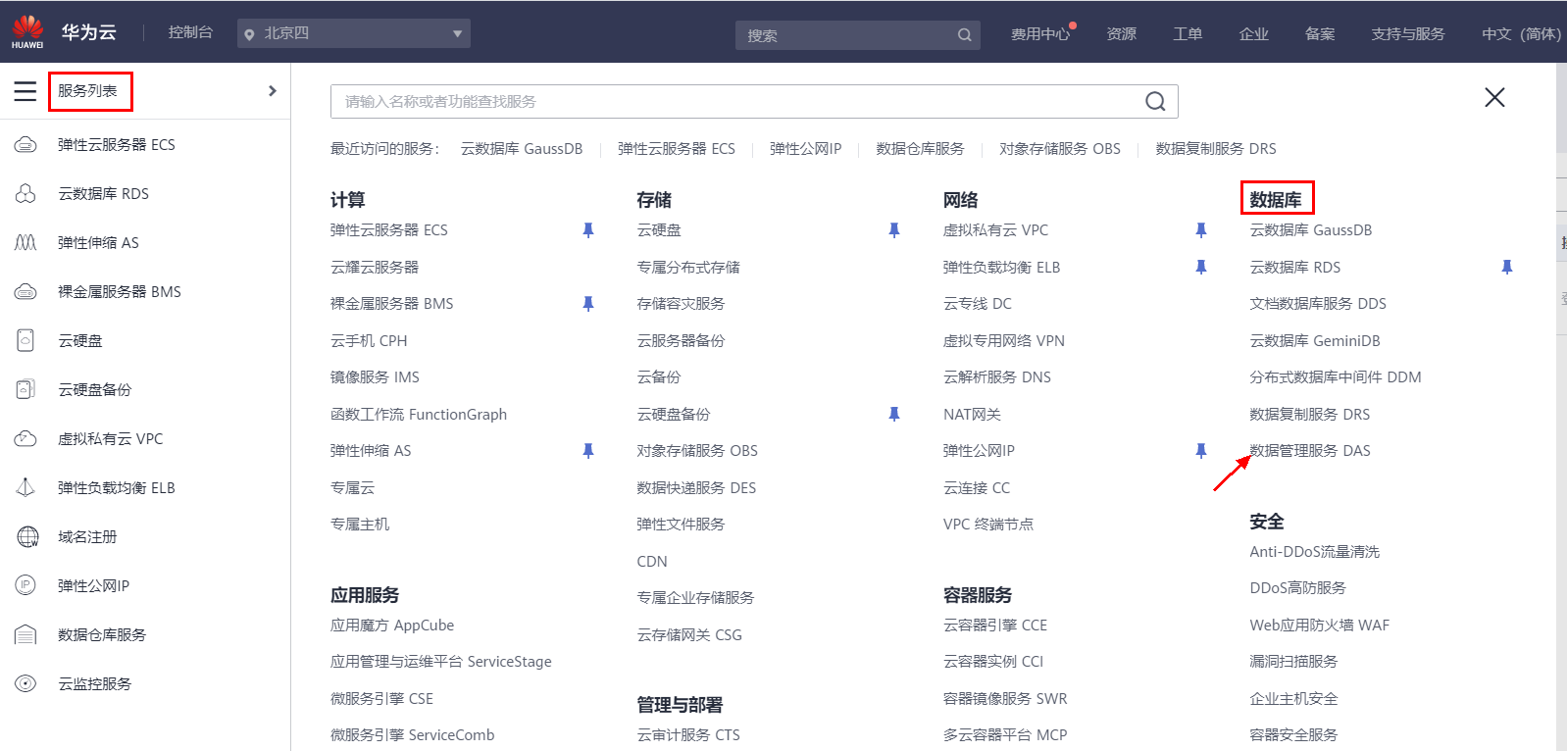
数据准备 (2)
(1)登录数据库。
登录华为云控制台，点击“服务列表”，在“服务列表中”选择“数据库”下的“数据管理服务DAS”。如下图2-1所示。
图2-1 数据库服务列表

Slide 7
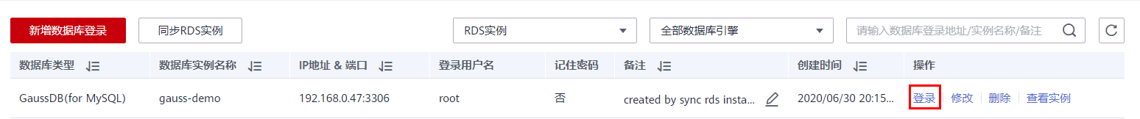
数据准备 (3)
点击“数据管理服务 DAS”中对应的GaussDB(for MySQL)的登录按钮。如图2-2所示。
图2-2 数据库登录

Slide 8
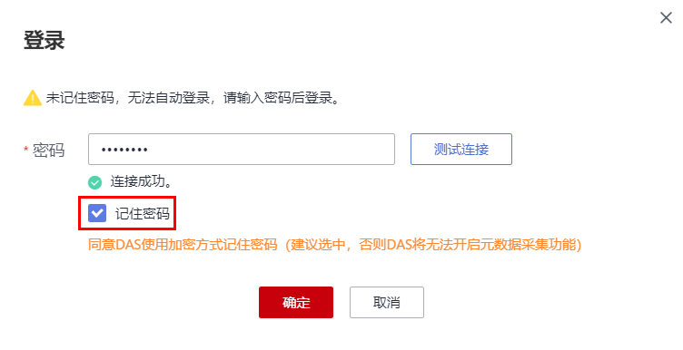
数据准备 (4)
输入创建GaussDB(for MySQL)时设置的root用户密码，并勾选“记住密码”后，点击“测试连接”，当出现“连接成功”的提示时，表示测试成功，点击“确定”按钮连接数据库。如图2-3所示。
图2-3 数据库连接测试

Slide 9
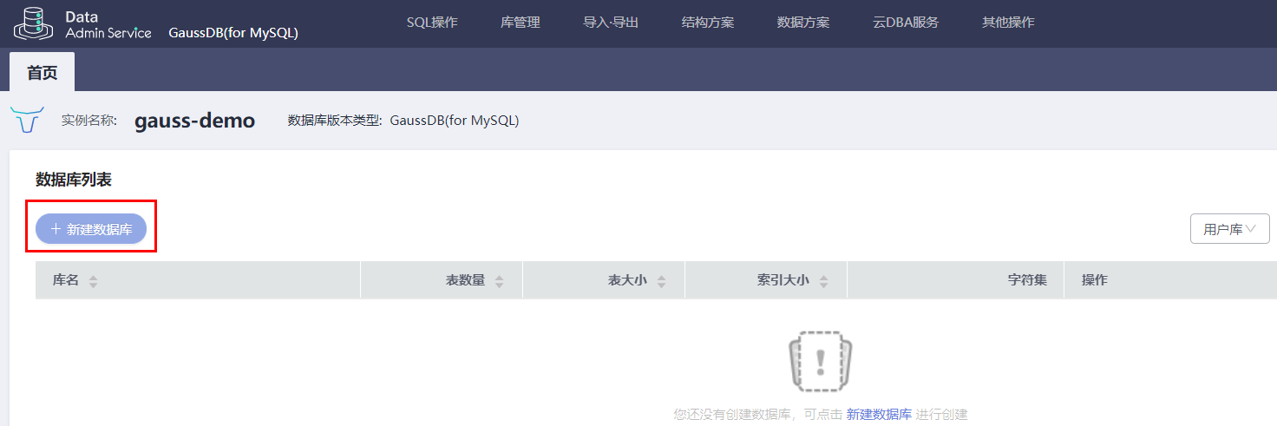
数据准备 (5)
(2)创建数据库。
进入“数据管理服务 DAS”后，点击“新建数据库”按钮。如图2-4所示
图2-4 新建数据库

Slide 10
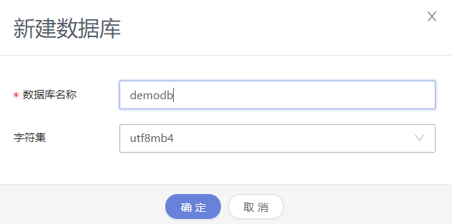
数据准备 (6)
输入新建数据库的数据库名demodb，选择对应的数据库字符集(默认使用utf8mb4)后，点击“确定”按钮。如图2-5所示。
图2-5 设置数据库基本信息

Slide 11
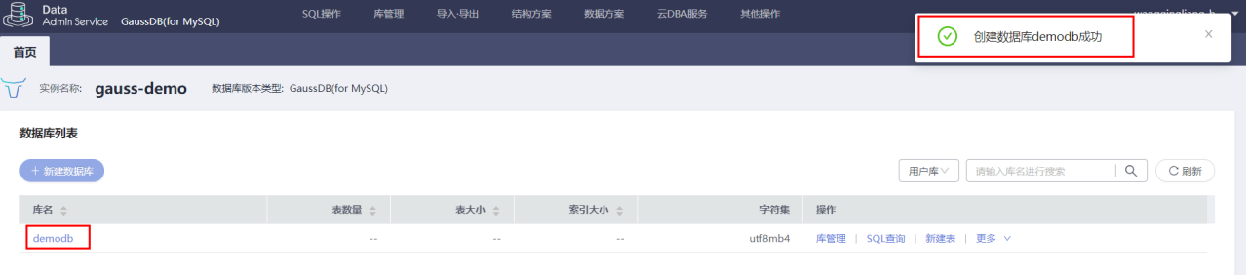
数据准备 (7)
在右侧会提示“创建数据库demodb成功”，并在下方的数据库列表中，显示出demodb数据库，以上执行完成，表示数据库创建成功。如图2-6所示。
图2-6 数据库创建成功界面

Slide 12
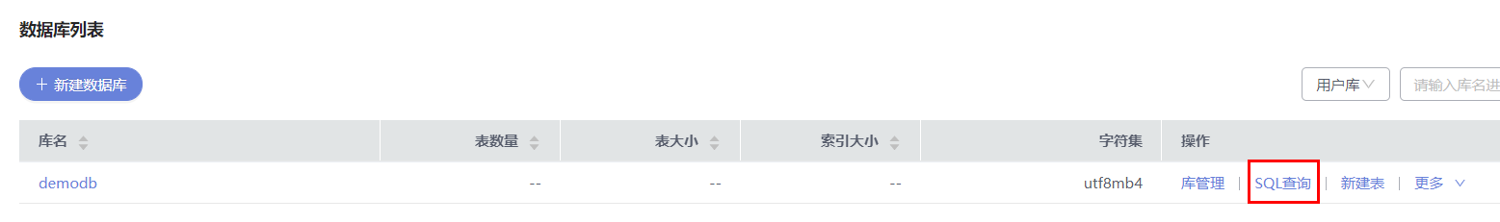
数据准备 (8)
(3)执行SQL。
点击“SQL查询”，进入SQL交互界面。如图2-7所示。
图2-7 SQL查询

Slide 13
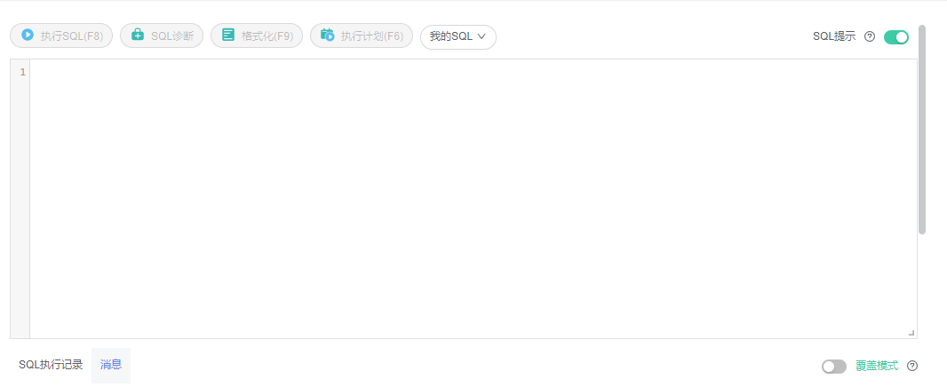
数据准备 (9)
将SQL文本贴入文本框中，点击“执行SQL”按钮或者使用F8执行SQL，在“消息”界面将展示执行结果。如图2-8所示。
图2-8 SQL文本框

Slide 14
数据准备 (10)
(4)创建表。
使用管理员用户登录数据库，执行以下初始化表的SQL。
① 创建employment_history表。代码如下。
create table employment_history (id int NOT NULL PRIMARY KEY AUTO_INCREMENT, staff_id INT, start_date DATETIME, end_date DATETIME,
employment_id VARCHAR(10), section_id INT );

Slide 15
数据准备 (11)
② 向employment_history表插入数据。代码如下。
insert into employment_history (staff_id, start_date, end_date, employment_id,section_id)values (102, '1993-01-13', '1998-07-24','IT_PROG', 60); insert into employment_history (staff_id, start_date, end_date, employment_id,section_id)values (101, '1989-09-21', '1993-10-27','AC_ACCOUNT', 110); insert into employment_history (staff_id, start_date, end_date, employment_id,section_id)values (101, '1993-10-28', '1997-03-15','AC_MGR', 110); insert into employment_history (staff_id, start_date, end_date, employment_id,section_id)values (201, '1996-02-17', '1999-12-19','MK_REP', 20); insert into employment_history (staff_id, start_date, end_date, employment_id,section_id)values (114, '1998-03-24', '1999-12-31','ST_CLERK', 50); insert into employment_history (staff_id, start_date, end_date, employment_id,section_id)values (122, '1999-01-01', '1999-12-31','ST_CLERK', 50);

Slide 16
数据准备 (12)
insert into employment_history (staff_id, start_date, end_date, employment_id,section_id)values (176, '1998-03-24', '1998-12-31','SA_REP', 80); insert into employment_history (staff_id, start_date, end_date, employment_id,section_id)values (176, '1999-01-01', '1999-12-31','SA_MAN', 80); insert into employment_history (staff_id, start_date, end_date, employment_id,section_id)values (200, '1994-07-01', '1998-12-31','AC_ACCOUNT', 90);

Slide 17
数据准备 (13)
③ 创建sections表。代码如下。
create table sections ( section_id INT not null, section_name VARCHAR(30), manager_id INT, place_id INT );

Slide 18
数据准备 (14)
④ 向sections表插入数据。代码如下。
insert into sections (section_id, section_name, manager_id, place_id)values (10, 'Administration', 200, 1700); insert into sections (section_id, section_name, manager_id, place_id)values (20, 'Marketing', 201, 1800); insert into sections (section_id, section_name, manager_id, place_id)values (30, 'Purchasing', 114, 1700); insert into sections (section_id, section_name, manager_id, place_id)values (40, 'Human Resources', 203, 2400); insert into sections (section_id, section_name, manager_id, place_id)values (50, 'Shipping', 121, 1500);

Slide 19
数据准备 (15)
insert into sections (section_id, section_name, manager_id, place_id)values (60, 'IT', 103, 1400); insert into sections (section_id, section_name, manager_id, place_id)values (70, 'Public Relations', 204, 2700); insert into sections (section_id, section_name, manager_id, place_id)values (80, 'Sales', 145, 2500); insert into sections (section_id, section_name, manager_id, place_id)values (90, 'Executive', 100, 1700); insert into sections (section_id, section_name, manager_id, place_id)values (100, 'Finance', 108, 1700); insert into sections (section_id, section_name, manager_id, place_id)values (110, 'Accounting', 205, 1700); insert into sections (section_id, section_name, manager_id, place_id)values (120, 'Treasury', null, 1700); insert into sections (section_id, section_name, manager_id, place_id)values (130, 'Corporate Tax', null, 1700); insert into sections (section_id, section_name, manager_id, place_id)values (140, 'Control And Credit', null, 1700);

Slide 20
数据准备 (16)
insert into sections (section_id, section_name, manager_id, place_id)values (150, 'Shareholder Services', null, 1700); insert into sections (section_id, section_name, manager_id, place_id)values (160, 'Benefits', null, 1700); insert into sections (section_id, section_name, manager_id, place_id)values (170, 'Manufacturing', null, 1700); insert into sections (section_id, section_name, manager_id, place_id)values (180, 'Construction', null, 1700); insert into sections (section_id, section_name, manager_id, place_id)values (190, 'Contracting', null, 1700); insert into sections (section_id, section_name, manager_id, place_id)values (200, 'Operations', null, 1700);

Slide 21
数据准备 (17)
insert into sections (section_id, section_name, manager_id, place_id)values (210, 'IT Support', null, 1700); insert into sections (section_id, section_name, manager_id, place_id)values (220, 'NOC', null, 1700); insert into sections (section_id, section_name, manager_id, place_id)values (230, 'IT Helpdesk', null, 1700); insert into sections (section_id, section_name, manager_id, place_id)values (240, 'Government Sales', null, 1700); insert into sections (section_id, section_name, manager_id, place_id)values (250, 'Retail Sales', null, 1700); insert into sections (section_id, section_name, manager_id, place_id)values (260, 'Recruiting', null, 1700); insert into sections (section_id, section_name, manager_id, place_id)values (270, 'Payroll', null, 1700);

Slide 22
数据准备 (18)
⑤ 创建places表。代码如下。
create table places ( place_id INT not null, street_address VARCHAR(40), postal_code VARCHAR(12), city VARCHAR(30), state_province VARCHAR(25), state_id CHAR(2) );

Slide 23
数据准备 (19)
⑥ 向places表插入数据。代码如下。
insert into places (place_id, street_address, postal_code, city, state_province,state_id)values (1000, '1297 Via Cola di Rie', '00989', 'Roma', '', 'IT'); insert into places (place_id, street_address, postal_code, city, state_province,state_id)values (1100, '93091 Calle della Testa', '10934', 'Venice', '', 'IT'); insert into places (place_id, street_address, postal_code, city, state_province,state_id)values (1200, '2017 Shinjuku-ku', '1689', 'Tokyo', 'Tokyo Prefecture', 'JP'); insert into places (place_id, street_address, postal_code, city, state_province,state_id)values (1300, '9450 Kamiya-cho', '6823', 'Hiroshima', '', 'JP'); insert into places (place_id, street_address, postal_code, city, state_province,state_id)values (1400, '2014 Jabberwocky Rd', '26192', 'Southlake', 'Texas', 'US');

Slide 24
数据准备 (20)
insert into places (place_id, street_address, postal_code, city, state_province,state_id)values (1500, '2011 Interiors Blvd', '99236', 'South San Francisco', 'California', 'US'); insert into places (place_id, street_address, postal_code, city, state_province,state_id)values (1600, '2007 Zagora St', '50090', 'South Brunswick', 'New Jersey', 'US'); insert into places (place_id, street_address, postal_code, city, state_province,state_id)values (1700, '2004 Charade Rd', '98199', 'Seattle', 'Washington', 'US'); insert into places (place_id, street_address, postal_code, city, state_province,state_id)values (1800, '147 Spadina Ave', 'M5V 2L7', 'Toronto', 'Ontario', 'CA');

Slide 25
数据准备 (21)
insert into places (place_id, street_address, postal_code, city, state_province,state_id)values (1900, '6092 Boxwood St', 'YSW 9T2', 'Whitehorse', 'Yukon', 'CA'); insert into places (place_id, street_address, postal_code, city, state_province,state_id)values (2000, '40-5-12 Laogianggen', '190518', 'Beijing', '', 'CN'); insert into places (place_id, street_address, postal_code, city, state_province,state_id)values (2100, '1298 Vileparle (E)', '490231', 'Bombay', 'Maharashtra', 'IN');
insert into places (place_id, street_address, postal_code, city, state_province,state_id)values (2200, '12-98 Victoria Street', '2901', 'Sydney', 'New South Wales', 'AU');

Slide 26
数据准备 (22)
insert into places (place_id, street_address, postal_code, city, state_province,state_id)values (2300, '198 Clementi North', '540198', 'Singapore', '', 'SG'); insert into places (place_id, street_address, postal_code, city, state_province,state_id)values (2400, '8204 Arthur St', '', 'London', '', 'UK'); insert into places (place_id, street_address, postal_code, city, state_province,state_id)values (2500, 'Magdalen Centre, The Oxford Science Park', 'OX9 9ZB', 'Oxford', 'Oxford','UK'); insert into places (place_id, street_address, postal_code, city, state_province,state_id)values (2600, '9702 Chester Road', '09629850293', 'Stretford', 'Manchester', 'UK');

Slide 27
数据准备 (23)
insert into places (place_id, street_address, postal_code, city, state_province,state_id)values (2700, 'Schwanthalerstr. 7031', '80925', 'Munich', 'Bavaria', 'DE'); insert into places (place_id, street_address, postal_code, city, state_province,state_id)values (2800, 'Rua Frei Caneca 1360 ', '01307-002', 'Sao Paulo', 'Sao Paulo', 'BR');
insert into places (place_id, street_address, postal_code, city, state_province,state_id)values (2900, '20 Rue des Corps-Saints', '1730', 'Geneva', 'Geneve', 'CH'); insert into places (place_id, street_address, postal_code, city, state_province,state_id)values (3000, 'Murtenstrasse 921', '3095', 'Bern', 'BE', 'CH'); insert into places (place_id, street_address, postal_code, city, state_province,state_id)values (3100, 'Pieter Breughelstraat 837', '3029SK', 'Utrecht', 'Utrecht', 'NL');

Slide 28
数据准备 (24)
insert into places (place_id, street_address, postal_code, city, state_province,state_id)values (3200, 'Mariano Escobedo 9991', '11932', 'Mexico City', 'Distrito Federal,', 'MX');

Slide 29
数据准备 (25)
⑦ 创建areas表。代码如下。
create table areas ( area_id INT, area_name VARCHAR(25) );

Slide 30
数据准备 (26)
⑧ 向areas表插入数据。代码如下。
insert into areas (area_id, area_name) values (1, 'Europe'); insert into areas (area_id, area_name) values (2, 'Americas'); insert into areas (area_id, area_name) values (3, 'Asia'); insert into areas (area_id, area_name) values (4, 'Middle East and Africa');

Slide 31
数据准备 (27)
⑨ 创建college表。代码如下。
create table college ( college_id INT, college_name VARCHAR(40) );

Slide 32
数据准备 (28)
⑩ 向college表插入数据。代码如下。
insert into college (college_id, college_name)values (1001, 'The University of Melbourne'); insert into college (college_id, college_name)values (1002, 'Duke University'); insert into college (college_id, college_name)values (1003, 'New York University'); insert into college (college_id, college_name)values (1004, 'Kings College London'); insert into college (college_id, college_name)values (1005, 'Tsinghua University'); insert into college (college_id, college_name)values (1006, 'University of Zurich'); insert into college (college_id, college_name)values (1007, 'Rice University'); insert into college (college_id, college_name)values (1008, 'Boston University'); insert into college (college_id, college_name)values (1009, 'Peking University'); insert into college (college_id, college_name)values (1010, 'Monash University');

Slide 33
数据准备 (29)
insert into college (college_id, college_name)values (1011, 'KU Leuven'); insert into college (college_id, college_name)values (1012, 'University of Basel'); insert into college (college_id, college_name)values (1013, 'Leiden University'); insert into college (college_id, college_name)values (1014, 'Erasmus University'); insert into college (college_id, college_name)values (1015, 'Ghent University'); insert into college (college_id, college_name)values (1016, 'Aarhus University');

Slide 34
数据准备 (30)
⑪ 创建employments表。代码如下。
create table employments ( employment_id VARCHAR(10) not null, employment_title VARCHAR(35), min_salary INT, max_salary INT );

Slide 35
数据准备 (31)
⑫ 向employments表插入数据。代码如下。
insert into employments (employment_id, employment_title, min_salary, max_salary)values ('AD_PRES', 'President', 20000, 40000); insert into employments (employment_id, employment_title, min_salary, max_salary)values ('AD_VP', 'Administration Vice President', 15000, 30000); insert into employments (employment_id, employment_title, min_salary, max_salary)values ('AD_ASST', 'Administration Assistant', 3000, 6000); insert into employments (employment_id, employment_title, min_salary, max_salary)values ('FI_MGR', 'Finance Manager', 8200, 16000); insert into employments (employment_id, employment_title, min_salary, max_salary)values ('FI_ACCOUNT', 'Accountant', 4200, 9000); insert into employments (employment_id, employment_title, min_salary, max_salary)values ('AC_MGR', 'Accounting Manager', 8200, 16000); insert into employments (employment_id, employment_title, min_salary, max_salary)values ('AC_ACCOUNT', 'Public Accountant', 4200, 9000);

Slide 36
数据准备 (32)
insert into employments (employment_id, employment_title, min_salary, max_salary)values ('SA_MAN', 'Sales Manager', 10000, 20000); insert into employments (employment_id, employment_title, min_salary, max_salary)values ('SA_REP', 'Sales Representative', 6000, 12000); insert into employments (employment_id, employment_title, min_salary, max_salary)values ('PU_MAN', 'Purchasing Manager', 8000, 15000); insert into employments (employment_id, employment_title, min_salary, max_salary)values ('PU_CLERK', 'Purchasing Clerk', 2500, 5500); insert into employments (employment_id, employment_title, min_salary, max_salary)values ('ST_MAN', 'Stock Manager', 5500, 8500); insert into employments (employment_id, employment_title, min_salary, max_salary)values ('ST_CLERK', 'Stock Clerk', 2000, 5000);

Slide 37
数据准备 (33)
⑬ 创建states表。代码如下。
create table states ( state_id CHAR(2), state_name VARCHAR(40), area_id INT, constraint state_c_id_pk primary key (state_ID) );

Slide 38
数据准备 (34)
⑭ 向states插入数据。代码如下。
insert into states (state_id, state_name, area_id)values ('AR', 'Argentina', 2); insert into states (state_id, state_name, area_id)values ('AU', 'Australia', 3); insert into states (state_id, state_name, area_id)values ('BE', 'Belgium', 1); insert into states (state_id, state_name, area_id)values ('BR', 'Brazil', 2); insert into states (state_id, state_name, area_id)values ('CA', 'Canada', 2); insert into states (state_id, state_name, area_id)values ('CH', 'Switzerland', 1); insert into states (state_id, state_name, area_id)values ('CN', 'China', 3); insert into states (state_id, state_name, area_id)values ('DE', 'Germany', 1); insert into states (state_id, state_name, area_id)values ('DK', 'Denmark', 1); insert into states (state_id, state_name, area_id)values ('EG', 'Egypt', 4); insert into states (state_id, state_name, area_id)values ('FR', 'France', 1); insert into states (state_id, state_name, area_id)values ('HK', 'HongKong', 3); insert into states (state_id, state_name, area_id)values ('IL', 'Israel', 4);

Slide 39
数据准备 (35)
insert into states (state_id, state_name, area_id)values ('IN', 'India', 3); insert into states (state_id, state_name, area_id)values ('IT', 'Italy', 1); insert into states (state_id, state_name, area_id)values ('JP', 'Japan', 3); insert into states (state_id, state_name, area_id)values ('KW', 'Kuwait', 4); insert into states (state_id, state_name, area_id)values ('MX', 'Mexico', 2); insert into states (state_id, state_name, area_id)values ('NG', 'Nigeria', 4); insert into states (state_id, state_name, area_id)values ('NL', 'Netherlands', 1); insert into states (state_id, state_name, area_id)values ('SG', 'Singapore', 3); insert into states (state_id, state_name, area_id)values ('UK', 'United Kingdom', 1); insert into states (state_id, state_name, area_id)values ('US', 'United States of America', 2); insert into states (state_id, state_name, area_id)values ('ZM', 'Zambia', 4); insert into states (state_id, state_name, area_id)values ('ZW', 'Zimbabwe', 4);

Slide 40
数据准备 (36)
⑮ 创建staffs表。代码如下。
CREATE TABLE staffs ( staff_id INT not null, first_name VARCHAR(20), last_name VARCHAR(25), email VARCHAR(25), phone_number VARCHAR(20), hire_date DATETIME, employment_id VARCHAR(10), salary DECIMAL(8,2), commission_pct DECIMAL(2,2), manager_id INT, section_id INT, graduated_name VARCHAR(60) );

Slide 41
数据准备 (37)
⑯ 向staffs表插入数据。代码如下。
insert into staffs (staff_id, first_name, last_name, email, phone_number, hire_date,employment_id, salary, commission_pct, manager_id, section_id)values (198, 'Donald', 'OConnell', 'DOCONNEL', '650.507.9833', str_to_date('21-06-1999', '%d-%m-%Y'), 'SH_CLERK', 2600.00, null, 124, 50); insert into staffs (staff_id, first_name, last_name, email, phone_number, hire_date,employment_id, salary, commission_pct, manager_id, section_id)values (199, 'Douglas', 'Grant', 'DGRANT', '650.507.9844', str_to_date('13-01-2000', '%d-%m-%Y'), 'SH_CLERK', 2600.00, null, 124, 50); insert into staffs (staff_id, first_name, last_name, email, phone_number, hire_date,employment_id, salary, commission_pct, manager_id, section_id)values (200, 'Jennifer', 'Whalen', 'JWHALEN', '515.123.4444', str_to_date('17-09-1987', '%d-%m-%Y'), 'AD_ASST', 4400.00, null, 101, 10);

Slide 42
数据准备 (38)
insert into staffs (staff_id, first_name, last_name, email, phone_number, hire_date,employment_id, salary, commission_pct, manager_id, section_id)values (201, 'Michael', 'Hartstein', 'MHARTSTE', '515.123.5555', str_to_date('17-02-1996', '%d-%m-%Y'), 'MK_MAN', 13000.00, null, 100, 20); insert into staffs (staff_id, first_name, last_name, email, phone_number, hire_date,employment_id, salary, commission_pct, manager_id, section_id)values (202, 'Pat', 'Fay', 'PFAY', '603.123.6666', str_to_date('17-08-1997', '%d-%m-%Y'),'MK_REP', 6000.00, null, 201, 20);
insert into staffs (staff_id, first_name, last_name, email, phone_number, hire_date,employment_id, salary, commission_pct, manager_id, section_id)values (203, 'Susan', 'Mavris', 'SMAVRIS', '515.123.7777', str_to_date('07-06-1994', '%d-%m-%Y'), 'HR_REP', 6500.00, null, 101, 40);

Slide 43
数据准备 (39)
insert into staffs (staff_id, first_name, last_name, email, phone_number, hire_date,employment_id, salary, commission_pct, manager_id, section_id)values (204, 'Hermann', 'Baer', 'HBAER', '515.123.8888', str_to_date('07-06-1994', '%d-%m-%Y'), 'PR_REP', 10000.00, null, 101, 70); insert into staffs (staff_id, first_name, last_name, email, phone_number, hire_date,employment_id, salary, commission_pct, manager_id, section_id)values (205, 'Shelley', 'Higgins', 'SHIGGINS', '515.123.8080', str_to_date('07-06-1994', '%d-%m-%Y'), 'AC_MGR', 12000.00, null, 101, 110);

Slide 44
数据准备 (40)
insert into staffs (staff_id, first_name, last_name, email, phone_number, hire_date,employment_id, salary, commission_pct, manager_id, section_id)values (206, 'William', 'Gietz', 'WGIETZ', '515.123.8181', str_to_date('07-06-1994', '%d-%m-%Y'), 'AC_ACCOUNT', 8300.00, null, 205, 110); insert into staffs (staff_id, first_name, last_name, email, phone_number, hire_date,employment_id, salary, commission_pct, manager_id, section_id)values (100, 'Steven', 'King', 'SKING', '515.123.4567', str_to_date('17-06-1987', '%d-%m-%Y'),'AD_PRES', 24000.00, null, null, 90);

Slide 45
数据准备 (41)
insert into staffs (staff_id, first_name, last_name, email, phone_number, hire_date,employment_id, salary, commission_pct, manager_id, section_id)values (101, 'Neena', 'Kochhar', 'NKOCHHAR', '515.123.4568', str_to_date('21-09-1989', '%d-%m-%Y'), 'AD_VP', 17000.00, null, 100, 90); insert into staffs (staff_id, first_name, last_name, email, phone_number, hire_date,employment_id, salary, commission_pct, manager_id, section_id)values (102, 'Lex', 'De Haan', 'LDEHAAN', '515.123.4569', str_to_date('13-01-1993', '%d-%m-%Y'), 'AD_VP', 17000.00, null, 100, 90); insert into staffs (staff_id, first_name, last_name, email, phone_number, hire_date,employment_id, salary, commission_pct, manager_id, section_id)values (103, 'Alexander', 'Hunold', 'AHUNOLD', '590.423.4567', str_to_date('03-01-1990', '%d-%m-%Y'), 'IT_PROG', 9000.00, null, 102, 60);

Slide 46
数据准备 (42)
insert into staffs (staff_id, first_name, last_name, email, phone_number, hire_date,employment_id, salary, commission_pct, manager_id, section_id)values (105, 'David', 'Austin', 'DAUSTIN', '590.423.4569', str_to_date('25-06-1997', '%d-%m-%Y'), 'IT_PROG', 4800.00, null, 103, 60); insert into staffs (staff_id, first_name, last_name, email, phone_number, hire_date,employment_id, salary, commission_pct, manager_id, section_id)values (106, 'Valli', 'Pataballa', 'VPATABAL', '590.423.4560', str_to_date('05-02-1998', '%d-%m-%Y'), 'IT_PROG', 4800.00, null, 103, 60); insert into staffs (staff_id, first_name, last_name, email, phone_number, hire_date,employment_id, salary, commission_pct, manager_id, section_id)values (107, 'Diana', 'Lorentz', 'DLORENTZ', '590.423.5567', str_to_date('07-02-1999', '%d-%m-%Y'), 'IT_PROG', 4200.00, null, 103, 60);

Slide 47
数据准备 (43)
insert into staffs (staff_id, first_name, last_name, email, phone_number, hire_date,employment_id, salary, commission_pct, manager_id, section_id) values (108, 'Nancy', 'Greenberg', 'NGREENBE', '515.124.4569', str_to_date('17-08-1994', '%d-%m-%Y'), 'FI_MGR', 12000.00, null, 101, 100); insert into staffs (staff_id, first_name, last_name, email, phone_number, hire_date,employment_id, salary, commission_pct, manager_id, section_id)values (109, 'Daniel', 'Faviet', 'DFAVIET', '515.124.4169', str_to_date('16-08-1994', '%d-%m-%Y'), 'FI_ACCOUNT', 9000.00, null, 108, 100); insert into staffs (staff_id, first_name, last_name, email, phone_number, hire_date,employment_id, salary, commission_pct, manager_id, section_id)values (110, 'John', 'Chen', 'JCHEN', '515.124.4269', str_to_date('28-09-1997', '%d-%m-%Y'),'FI_ACCOUNT', 8200.00, null, 108, 100);

Slide 48
数据查询 (1)
本小节通过DQL语言来演示如何从表中查询数据，包括简单查询、带条件查询、连接查询、子查询、UNION、MINUS、数据分组、排序和限制等。了解数据查询DQL语法结构，掌握不同场景下DQL语言的使用。

Slide 49
数据查询 (2)
(1)实验任务
① 简单查询：SELECT是通过FROM子句实现的查询。
SELECT后面使用*号查询employments表中的所有列。代码如下。

Slide 50
数据查询 (3)
select * from employments; # employment_id, employment_title, min_salary, max_salary AD_PRES, President, 20000, 40000 AD_VP, Administration Vice President, 15000, 30000 AD_ASST, Administration Assistant, 3000, 6000 FI_MGR, Finance Manager, 8200, 16000 FI_ACCOUNT, Accountant, 4200, 9000 AC_MGR, Accounting Manager, 8200, 16000 AC_ACCOUNT, Public Accountant, 4200, 9000 SA_MAN, Sales Manager, 10000, 20000 SA_REP, Sales Representative, 6000, 12000 PU_MAN, Purchasing Manager, 8000, 15000 PU_CLERK, Purchasing Clerk, 2500, 5500 ST_MAN, Stock Manager, 5500, 8500 ST_CLERK, Stock Clerk, 2000, 5000

Slide 51
数据查询 (4)
② 查看employments表中的岗位ID和最低薪水。代码如下。
select EMPLOYMENT_ID, MIN_SALARY from employments; # EMPLOYMENT_ID, MIN_SALARY AD_PRES, 20000 AD_VP, 15000 AD_ASST, 3000 FI_MGR, 8200 FI_ACCOUNT, 4200 AC_MGR, 8200 AC_ACCOUNT, 4200 SA_MAN, 10000 SA_REP, 6000 PU_MAN, 8000 PU_CLERK, 2500 ST_MAN, 5500 ST_CLERK, 2000

Slide 52
数据查询 (5)
③ employments表别名使用。代码如下。
select EMPLOYMENT_ID as id,MIN_SALARY from employments; # id, MIN_SALARY AD_PRES, 20000 AD_VP, 15000 AD_ASST, 3000 FI_MGR, 8200 FI_ACCOUNT, 4200 AC_MGR, 8200 AC_ACCOUNT, 4200 SA_MAN, 10000 SA_REP, 6000 PU_MAN, 8000 PU_CLERK, 2500 ST_MAN, 5500 ST_CLERK, 2000

Slide 53
数据查询 (6)
④ 带条件查询：在SELECT语句中，可以通过设置条件以达到更精确的查询。
使用比较操作符“>、 <、 >=、 <=、 !=、 <>、 =”来指定查询条件，在雇员表中查询岗位是FI_ACCOUNT的雇员信息。代码如下。
select staff_id,first_name,EMPLOYMENT_ID from staffs where EMPLOYMENT_ID = 'FI_ACCOUNT'; # staff_id, first_name, EMPLOYMENT_ID 109, Daniel, FI_ACCOUNT 110, John, FI_ACCOUNT

Slide 54
数据查询 (7)
⑤ 从staffs表中查询1995年后入职，且薪酬>5000的职员信息。代码如下。
select staff_id,first_name,hire_date,salary from staffs WHERE HIRE_DATE>'1995-01-01 00:00:00'and salary>'5000'; # staff_id, first_name, hire_date, salary 201, Michael, 1996-02-17 00:00:00, 13000.00 202, Pat, 1997-08-17 00:00:00, 6000.00 110, John, 1997-09-28 00:00:00, 8200.00

Slide 55
数据查询 (8)
⑥ 从staffs表和employment_history表中查看员工的姓名入职时间。代码如下。
SELECT e.start_date,s.first_name,s.last_name FROM employment_history e, staffs s WHERE e.staff_id = s.staff_id; # start_date, first_name, last_name 1994-07-01 00:00:00, Jennifer, Whalen 1987-09-17 00:00:00, Jennifer, Whalen 1996-02-17 00:00:00, Michael, Hartstein 1993-10-28 00:00:00, Neena, Kochhar 1989-09-21 00:00:00, Neena, Kochhar 1993-01-13 00:00:00, Lex, De Haan

Slide 56
数据查询 (9)
⑦ 连接查询(join)
实际应用中所需要的数据，经常会需要查询两个或两个以上的表。这种查询两个或两个以上数据表或视图的查询叫做连接查询。连接查询通常建立在存在相互关系的父子表之间。
1)内连接的关键字为inner join，其中inner可以省略。使用内连接，连接执行顺序必然遵循语句中所写的表的顺序。使用内连接联合查询表。查询经理ID、部门名称，使用staffs和sections两个表中相关的列(manager_id)做连接查询操作。代码如下。

Slide 57
数据查询 (10)
select a.manager_id,section_name from staffs a join sections b on a.manager_id=b.manager_id; # manager_id, section_name 201, Marketing 103, IT 103, IT 103, IT 103, IT 100, Executive 100, Executive 100, Executive 108, Finance 108, Finance 205, Accounting

Slide 58
数据查询 (11)
2)使用左外连接查询表staffs和表sections。代码如下。
select a.manager_id,section_name from staffs a left join sections b on a.manager_id=b.manager_id; # manager_id, section_name 124, 124, 101, 100, Executive 201, Marketing 101, 101, 101, 205, Accounting ,

Slide 59
数据查询 (12)
# manager_id, section_name
100, Executive 100, Executive 102, 103, IT 103, IT 103, IT 103, IT 101, 108, Finance 108, Finance

Slide 60
数据查询 (13)
3)使用右外连接查询表staffs和表sections。 代码如下。
select a.manager_id,section_name from staffs a right join sections b on a.manager_id=b.manager_id; # manager_id, section_name , Administration 201, Marketing , Purchasing , Human Resources , Shipping 103, IT 103, IT 103, IT

Slide 61
数据查询 (14)
103, IT , Public Relations , Sales 100, Executive 100, Executive 100, Executive 108, Finance 108, Finance

Slide 62
数据查询 (15)
205, Accounting , Treasury , Corporate Tax , Control And Credit , Shareholder Services , Benefits , Manufacturing , Construction , Contracting , Operations , IT Support , NOC , IT Helpdesk , Government Sales , Retail Sales , Recruiting , Payroll

Slide 63
数据查询 (16)
⑧ 子查询，将子查询的结果集作为条件进行父查询。通过相关子查询，查找每个部门中高出部门平均工资的人员。代码如下。
SELECT s1.last_name, s1.section_id, s1.salary FROM staffs s1 WHERE salary >(SELECT avg(salary) FROM staffs s2 WHERE s2.section_id = s1.section_id) ORDER BY s1.section_id;

Slide 64
数据查询 (17)
对于staffs表的每一行，父查询使用相关子查询来计算同一部门成员的平均工资。
相关子查询为staffs表的每一行执行以下步骤。
1)确定行的section_id。
2)然后使用section_id来评估父查询。
3)如果此行中工资大于所在部门的平均工资，则返回该行。

Slide 65
数据查询 (18)
对于staffs表的每一行，子查询都将被计算一次。
查询结果如下。
# last_name, section_id, salary Hartstein, 20, 13000.00 Hunold, 60, 9000.00 Ernst, 60, 6000.00 King, 90, 24000.00 Greenberg, 100, 12000.00 Higgins, 110, 12000.00

Slide 66
数据查询 (19)
⑨ 数据分组：使用GROUP BY子句对查询语句进行分组。查询各部门员工总数，按照section_id分组。代码如下。
SELECT section_id, COUNT(staff_id) FROM staffs GROUP BY section_id ORDER BY section_id; # section_id, COUNT(staff_id) 10, 1 20, 2 40, 1 50, 2 60, 5 70, 1 90, 3 100, 3 110, 2

Slide 67
数据查询 (20)
⑩ 数据排序：使用ORDER BY子句对查询语句返回的行根据指定的列进行排序。
查询员工各岗位的薪水信息，查询结果先按岗位employment_id升序排列，然后按salary降序排列。代码如下。
FI_ACCOUNT, 109, 9000.00 FI_ACCOUNT, 110, 8200.00 FI_MGR, 108, 12000.00 HR_REP, 203, 6500.00 IT_PROG, 103, 9000.00 IT_PROG, 104, 6000.00 IT_PROG, 105, 4800.00 IT_PROG, 106, 4800.00 IT_PROG, 107, 4200.00 MK_MAN, 201, 13000.00 MK_REP, 202, 6000.00 PR_REP, 204, 10000.00 SH_CLERK, 199, 2600.00 SH_CLERK, 198, 2600.00
select employment_id,staff_id,salary from staffs order by employment_id,salary desc; # employment_id, staff_id, salary AC_ACCOUNT, 206, 8300.00 AC_MGR, 205, 12000.00 AD_ASST, 200, 4400.00 AD_PRES, 100, 24000.00 AD_VP, 102, 17000.00 AD_VP, 101, 17000.00

Slide 68
数据查询 (21)
⑪ 在ORDER BY子句中使用位置表示法，数字表示该排序字段是查询字段列表的第几个字段。代码如下。
select employment_id,staff_id,salary from staffs order by 1,3 desc; # employment_id, staff_id, salary AC_ACCOUNT, 206, 8300.00 AC_MGR, 205, 12000.00 AD_ASST, 200, 4400.00 AD_PRES, 100, 24000.00 AD_VP, 102, 17000.00 AD_VP, 101, 17000.00 FI_ACCOUNT, 109, 9000.00 FI_ACCOUNT, 110, 8200.00
FI_MGR, 108, 12000.00 HR_REP, 203, 6500.00 IT_PROG, 103, 9000.00
IT_PROG, 104, 6000.00
IT_PROG, 105, 4800.00 IT_PROG, 106, 4800.00 IT_PROG, 107, 4200.00 MK_MAN, 201, 13000.00 MK_REP, 202, 6000.00 PR_REP, 204, 10000.00 SH_CLERK, 199, 2600.00 SH_CLERK, 198, 2600.00

Slide 69
数据查询 (22)
⑫ 数据限制：LIMIT子句允许限制查询返回的行。
可以指定偏移量，以及要返回的行数或行百分比。 可以使用此子句实现top-N报表。要获得一致的结果，请指定ORDER BY子句以确保确定性排序顺序。
先不使用LIMIT子句进行查询，与使用LIMIT子句进行查询的结果进行对比。查询薪水超过7000的员工信息。代码如下。
select staff_id,first_name,employment_id,salary from staffs where salary>7000; # staff_id, first_name, employment_id, salary 201, Michael, MK_MAN, 13000.00 204, Hermann, PR_REP, 10000.00 205, Shelley, AC_MGR, 12000.00
206, William, AC_ACCOUNT, 8300.00 100, Steven, AD_PRES, 24000.00 101, Neena, AD_VP, 17000.00 102, Lex, AD_VP, 17000.00 103, Alexander, IT_PROG, 9000.00 108, Nancy, FI_MGR, 12000.00 109, Daniel, FI_ACCOUNT, 9000.00 110, John, FI_ACCOUNT, 8200.00

Slide 70
数据查询 (23)
⑬ 查询获得奖金超过7000的员工信息。通过增加LIMIT 2,2限定查询时跳过前2行后，查询总共2行数据。代码如下。
select staff_id,first_name,employment_id,salary from staffs where salary>7000 limit 2,2; # staff_id, first_name, employment_id, salary 205, Shelley, AC_MGR, 12000.00 206, William, AC_ACCOUNT, 8300.00

Slide 71
数据查询 (24)
⑭ 查询获得奖金超过7000的员工信息。通过增加LIMIT 2 OFFSET 2限定查询时跳过前2行后，查询总共2行数据，与使用LIMIT 2,2限定查询返回结果等效。代码如下。
select staff_id,first_name,employment_id,salary from staffs where salary>7000 limit 2 offset 2; # staff_id, first_name, employment_id, salary 205, Shelley, AC_MGR, 12000.00 206, William, AC_ACCOUNT, 8300.00

Slide 72
数据更新 (1)
本节介绍数据操作语言DML(Data Manipulation Language)，演示如何通过DML语言来对数据库表中的数据进行更新操作。主要包括：数据插入、数据修改和数据删除。了解数据操作语言DML语法结构，掌握不同场景下DML语言的使用。实验任务如下。

Slide 73
数据更新 (2)
(1)数据插入：在表中插入新的数据。
INSERT语句有以下三种形式。
第一种是值插入，即构造一行记录并插入到表中。
第二种形式是查询插入，它通过SELECT子句返回的结果集构造一行或多行记录插入到表中。
第三种是先插入记录，如果报主键冲突错误则执行UPDATE操作，更新指定字段值。

Slide 74
数据更新 (3)
① 更换管理员用户登录workbench，并进入demodb数据库。代码如下。
② 删除表sections。代码如下。
use demodb;
DROP TABLE IF EXISTS sections;

Slide 75
数据更新 (4)
③ 创建sections表。代码如下。
create table sections ( section_id INT not null primary key, section_name VARCHAR(30), manager_id INT, place_id INT );

Slide 76
数据更新 (5)
④ 向表sections中插入数据。代码如下。
insert into sections (section_id, section_name, manager_id, place_id)values (10, 'Administration', 200, 1700); insert into sections (section_id, section_name, manager_id, place_id)values (20, 'Marketing', 201, 1800); insert into sections (section_id, section_name, manager_id, place_id)values (30, 'Purchasing', 114, 1700); insert into sections (section_id, section_name, manager_id, place_id)values (40, 'Human Resources', 203, 2400); insert into sections (section_id, section_name, manager_id, place_id)values (50, 'Shipping', 121, 1500); insert into sections (section_id, section_name, manager_id, place_id)values (60, 'IT', 103, 1400); insert into sections (section_id, section_name, manager_id, place_id)values (70, 'Public Relations', 204, 2700); insert into sections (section_id, section_name, manager_id, place_id)values (80, 'Sales', 145, 2500);

Slide 77
数据更新 (6)
insert into sections (section_id, section_name, manager_id, place_id)values (90, 'Executive', 100, 1700); insert into sections (section_id, section_name, manager_id, place_id)values (100, 'Finance', 108, 1700); insert into sections (section_id, section_name, manager_id, place_id)values (110, 'Accounting', 205, 1700);

Slide 78
数据更新 (7)
(2)数据修改：更新表sections中section_id和表employment_history中section_id相同的记录。
① 查询表sections记录。代码如下。
select * from sections; # section_id, section_name, manager_id, place_id 10, Administration, 200, 1700 20, Marketing, 201, 1800
30, Purchasing, 114, 1700 40, Human Resources, 203, 2400 50, Shipping, 121, 1500 60, IT, 103, 1400 70, Public Relations, 204, 2700
80, Sales, 145, 2500 90, Executive, 100, 1700 100, Finance, 108, 1700 110, Accounting, 205, 1700

Slide 79
数据更新 (8)
② 更新表sections中section_id和表employment_history中section_id相同的记录，修改 manager_id为其他值。代码如下。
UPDATE sections INNER JOIN employment_history ON sections.section_id = employment_history.section_id SET sections.manager_id = 200;

Slide 80
数据更新 (9)
③ 查询表sections记录。代码如下。
select * from sections; # section_id, section_name, manager_id, place_id 10, Administration, 200, 1700 20, Marketing, 200, 1800 30, Purchasing, 114, 1700 40, Human Resources, 203, 2400 50, Shipping, 200, 1500 60, IT, 200, 1400 70, Public Relations, 204, 2700 80, Sales, 200, 2500 90, Executive, 200, 1700 100, Finance, 108, 1700 110, Accounting, 200, 1700

Slide 81
数据更新 (10)
④ 查询表employment_history的记录。代码如下。
select * from employment_history; # id, staff_id, start_date, end_date, employment_id, section_id 1, 102, 1993-01-13 00:00:00, 1998-07-24 00:00:00, IT_PROG, 60 2, 101, 1989-09-21 00:00:00, 1993-10-27 00:00:00, AC_ACCOUNT, 110 3, 101, 1993-10-28 00:00:00, 1997-03-15 00:00:00, AC_MGR, 110 4, 201, 1996-02-17 00:00:00, 1999-12-19 00:00:00, MK_REP, 20
5, 114, 1998-03-24 00:00:00, 1999-12-31 00:00:00, ST_CLERK, 50 6, 122, 1999-01-01 00:00:00, 1999-12-31 00:00:00, ST_CLERK, 50 7, 200, 1987-09-17 00:00:00, 1993-06-17 00:00:00, AD_ASST, 90 8, 176, 1998-03-24 00:00:00, 1998-12-31 00:00:00, SA_REP, 80 9, 176, 1999-01-01 00:00:00, 1999-12-31 00:00:00, SA_MAN, 80 10, 200, 1994-07-01 00:00:00, 1998-12-31 00:00:00, AC_ACCOUNT, 90

Slide 82
数据更新 (11)
⑤ 更新表employment_history的数据。代码如下。
#关闭安全模式，允许更新主键以外的列 SET SQL_SAFE_UPDATES = 0; #更新表 UPDATE employment_history SET EMPLOYMENT_ID='SA_REP' WHERE staff_id=101;

Slide 83
数据更新 (12)
⑥ 查询表employment_history的记录。代码如下。
select * from employment_history; # id, staff_id, start_date, end_date, employment_id, section_id 1, 102, 1993-01-13 00:00:00, 1998-07-24 00:00:00, IT_PROG, 60 2, 101, 1989-09-21 00:00:00, 1993-10-27 00:00:00, SA_REP, 110 3, 101, 1993-10-28 00:00:00, 1997-03-15 00:00:00, SA_REP, 110 4, 201, 1996-02-17 00:00:00, 1999-12-19 00:00:00, MK_REP, 20 5, 114, 1998-03-24 00:00:00, 1999-12-31 00:00:00, ST_CLERK, 50 6, 122, 1999-01-01 00:00:00, 1999-12-31 00:00:00, ST_CLERK, 50 7, 200, 1987-09-17 00:00:00, 1993-06-17 00:00:00, AD_ASST, 90 8, 176, 1998-03-24 00:00:00, 1998-12-31 00:00:00, SA_REP, 80 9, 176, 1999-01-01 00:00:00, 1999-12-31 00:00:00, SA_MAN, 80 10, 200, 1994-07-01 00:00:00, 1998-12-31 00:00:00, AC_ACCOUNT, 90

Slide 84
数据更新 (13)
(3)数据删除：从表中删除行。代码如下。
① 删除表中与另外一个表匹配的行记录。代码如下。
或
DELETE table_ref_list FROM join_table;
DELETE FROM table_ref_list USING join_table;

Slide 85
数据更新 (14)
② 批量删除表sections中section_id和表employment_history中section_id相同的记录。
查询表sections记录。代码如下。
select * from sections; # section_id, section_name, manager_id, place_id 10, Administration, 200, 1700 20, Marketing, 200, 1800 30, Purchasing, 114, 1700 40, Human Resources, 203, 2400 50, Shipping, 200, 1500 60, IT, 200, 1400 70, Public Relations, 204, 2700 80, Sales, 200, 2500 90, Executive, 200, 1700 100, Finance, 108, 1700 110, Accounting, 200, 1700

Slide 86
数据更新 (15)
③ 批量删除表sections中section_id和表employment_history中section_id相同的记录。代码如下。
④ 查询表sections记录。代码如下
DELETE sections FROM employment_history JOIN sections ON sections.section_id = employment_history.section_id;
select * from sections; # section_id, section_name, manager_id, place_id 10, Administration, 200, 1700 30, Purchasing, 114, 1700 40, Human Resources, 203, 2400 70, Public Relations, 204, 2700 100, Finance, 108, 1700

Slide 87
数据更新 (16)
⑤ 查询表employment_history的记录。代码如下。
select * from employment_history; # id, staff_id, start_date, end_date, employment_id, section_id 1, 102, 1993-01-13 00:00:00, 1998-07-24 00:00:00, IT_PROG, 60 2, 101, 1989-09-21 00:00:00, 1993-10-27 00:00:00, SA_REP, 110 3, 101, 1993-10-28 00:00:00, 1997-03-15 00:00:00, SA_REP, 110 4, 201, 1996-02-17 00:00:00, 1999-12-19 00:00:00, MK_REP, 20 5, 114, 1998-03-24 00:00:00, 1999-12-31 00:00:00, ST_CLERK, 50
6, 122, 1999-01-01 00:00:00, 1999-12-31 00:00:00, ST_CLERK, 50 7, 200, 1987-09-17 00:00:00, 1993-06-17 00:00:00, AD_ASST, 90 8, 176, 1998-03-24 00:00:00, 1998-12-31 00:00:00, SA_REP, 80 9, 176, 1999-01-01 00:00:00, 1999-12-31 00:00:00, SA_MAN, 80 10, 200, 1994-07-01 00:00:00, 1998-12-31 00:00:00, AC_ACCOUNT, 90

Slide 88
数据更新 (17)
⑥ 删除表employment_history中同时匹配EMPLOYMENT_ID='AD_ASST'和staff_id=200的记录。代码如下。
DELETE FROM employment_history WHERE EMPLOYMENT_ID='AD_ASST' AND staff_id=200;

Slide 89
数据更新 (18)
⑦ 查询表employment_history的记录。代码如下。
select * from employment_history;
# id, staff_id, start_date, end_date, employment_id, section_id 1, 102, 1993-01-13 00:00:00, 1998-07-24 00:00:00, IT_PROG, 60 2, 101, 1989-09-21 00:00:00, 1993-10-27 00:00:00, SA_REP, 110 3, 101, 1993-10-28 00:00:00, 1997-03-15 00:00:00, SA_REP, 110 4, 201, 1996-02-17 00:00:00, 1999-12-19 00:00:00, MK_REP, 20 5, 114, 1998-03-24 00:00:00, 1999-12-31 00:00:00, ST_CLERK, 50
6, 122, 1999-01-01 00:00:00, 1999-12-31 00:00:00, ST_CLERK, 50 8, 176, 1998-03-24 00:00:00, 1998-12-31 00:00:00, SA_REP, 80 9, 176, 1999-01-01 00:00:00, 1999-12-31 00:00:00, SA_MAN, 80 10, 200, 1994-07-01 00:00:00, 1998-12-31 00:00:00, AC_ACCOUNT, 90

Slide 90
数据更新 (19)
⑧ 删除表sections的全部数据，删除表sectios的全部记录。代码如下。
⑨ 查询表sections记录。代码如下。
DELETE FROM sections;
select * from sections; # section_id, section_name, manager_id, place_id.

Slide 91
数据定义 (1)
本节介绍数据定义语言DDL(Data Definition Language)，演示如何通过DDL语言来定义或修改数据库中的对象。如：表、索引、视图、数据库、用户、角色、表空间等。学习本节之后要了解数据定义语言DDL语法结构，掌握不同场景下DDL语言的使用。实验任务如下。

Slide 92
数据定义 (2)
(1)定义表
表是数据库中的一种特殊数据结构，用于存储数据对象以及对象之间的关系。表相关的DDL包括创建表、修改表属性、删除表和删除表中所有数据。
① 相关概念
创建表时使用表名(如，staffs)和一组列定义表。每个列有两个属性，列名和数据类型(如，列名STAFF_ID，指定数据类型为INT；列名FIRST_NAME，数据类型为VARCHAR(20 BYTE)。每一列可以指定完整性约束(NOT NULL)，以保证这一列的每行中必须包含一个值。
创建表之后，可以使用INSERT命令插入数据或使用数据导入导出工具装载数据，还可以直接使用CREATE TABLE AS query创建一个包含数据的表。

Slide 93
数据定义 (3)
表的列和相关的数据类型：列的数据类型决定该列包含数据值的类型。选择使用尽可能少的空间，仍能保存用户数据的数据类型。比如：使用varchar类型存储字符串，使用datetime或者timestamp存储日期，使用int类型存储数字。当使用空格填充类型的时候，增加容量使用CHAR、VARCHAR和TEXT数据类型没有性能差异。在大多数情况下使用TEXT或VARCHAR优于CHAR。

Slide 94
数据定义 (4)
如果要连接两个表，则连接的那一列需要有相同的数据类型。表的连接通常是一个表的主键和另一个表的外键。如果数据类型不同，数据库必须将其中的一个进行转化，则会导致数据值需要比较正确性，引起不必要的开销。
表和列的约束。如果定义表和列的约束条件，则表和列中包含的数据就会受到限制。
– [ NOT ] NULL 是否允许该列值为空。
– UNIQUE 值唯一，允许为空，一个表可以多个列为UNIQUE。
– PRIMARY KEY 主键，设为主键的列不能为空，一个表只能建立一 个主键。

Slide 95
数据定义 (5)
② 创建表：创建staffs普通表。代码如下。
DROP TABLE IF EXISTS staffs; CREATE TABLE staffs ( staff_id INT UNSIGNED NOT NULL, first_name VARCHAR(20), last_name VARCHAR(25), email VARCHAR(25), phone_number VARCHAR(20), hire_date DATETIME, employment_id VARCHAR(10), salary DECIMAL(8,2), commission_pct DECIMAL(2,2), manager_id INT, section_id INT, graduated_name VARCHAR(60)
);

Slide 96
数据定义 (6)
③ 向staffs表中插入数据。代码如下。
insert into staffs (staff_id, first_name, last_name, email, phone_number, hire_date,employment_id, salary, commission_pct, manager_id, section_id)values (198, 'Donald', 'OConnell', 'DOCONNEL', '650.507.9833', str_to_date('21-06-1999', '%d-%m-%Y'), 'SH_CLERK', 2600.00, null, 124, 50); insert into staffs (staff_id, first_name, last_name, email, phone_number, hire_date,employment_id, salary, commission_pct, manager_id, section_id)values (199, 'Douglas', 'Grant', 'DGRANT', '650.507.9844', str_to_date('13-01-2000', '%d-%m-%Y'), 'SH_CLERK', 2600.00, null, 124, 50); insert into staffs (staff_id, first_name, last_name, email, phone_number, hire_date,employment_id, salary, commission_pct, manager_id, section_id)values (200, 'Jennifer', 'Whalen', 'JWHALEN', '515.123.4444', str_to_date('17-09-1987', '%d-%m-%Y'), 'AD_ASST', 4400.00, null, 101, 10); insert into staffs (staff_id, first_name, last_name, email, phone_number, hire_date,employment_id, salary, commission_pct, manager_id, section_id)values (201, 'Michael', 'Hartstein', 'MHARTSTE', '515.123.5555', str_to_date('17-02-1996', '%d-%m-%Y'), 'MK_MAN', 13000.00, null, 100, 20); insert into staffs (staff_id, first_name, last_name, email, phone_number, hire_date,employment_id, salary, commission_pct, manager_id, section_id)values (202, 'Pat', 'Fay', 'PFAY', '603.123.6666', str_to_date('17-08-1997', '%d-%m-%Y'),'MK_REP', 6000.00, null, 201, 20);

Slide 97
数据定义 (7)
③ 向staffs表中插入数据。代码如下。
insert into staffs (staff_id, first_name, last_name, email, phone_number, hire_date,employment_id, salary, commission_pct, manager_id, section_id)values (203, 'Susan', 'Mavris', 'SMAVRIS', '515.123.7777', str_to_date('07-06-1994', '%d-%m-%Y'), 'HR_REP', 6500.00, null, 101, 40); insert into staffs (staff_id, first_name, last_name, email, phone_number, hire_date,employment_id, salary, commission_pct, manager_id, section_id)values (204, 'Hermann', 'Baer', 'HBAER', '515.123.8888', str_to_date('07-06-1994', '%d-%m-%Y'), 'PR_REP', 10000.00, null, 101, 70); insert into staffs (staff_id, first_name, last_name, email, phone_number, hire_date,employment_id, salary, commission_pct, manager_id, section_id)values (205, 'Shelley', 'Higgins', 'SHIGGINS', '515.123.8080', str_to_date('07-06-1994', '%d-%m-%Y'), 'AC_MGR', 12000.00, null, 101, 110); insert into staffs (staff_id, first_name, last_name, email, phone_number, hire_date,employment_id, salary, commission_pct, manager_id, section_id)values (206, 'William', 'Gietz', 'WGIETZ', '515.123.8181', str_to_date('07-06-1994', '%d-%m-%Y'), 'AC_ACCOUNT', 8300.00, null, 205, 110); insert into staffs (staff_id, first_name, last_name, email, phone_number, hire_date,employment_id, salary, commission_pct, manager_id, section_id)values (100, 'Steven', 'King', 'SKING', '515.123.4567', str_to_date('17-06-1987', '%d-%m-%Y'),'AD_PRES', 24000.00, null, null, 90);

Slide 98
数据定义 (8)
insert into staffs (staff_id, first_name, last_name, email, phone_number, hire_date,employment_id, salary, commission_pct, manager_id, section_id)values (101, 'Neena', 'Kochhar', 'NKOCHHAR', '515.123.4568', str_to_date('21-09-1989', '%d-%m-%Y'), 'AD_VP', 17000.00, null, 100, 90); insert into staffs (staff_id, first_name, last_name, email, phone_number, hire_date,employment_id, salary, commission_pct, manager_id, section_id)values (102, 'Lex', 'De Haan', 'LDEHAAN', '515.123.4569', str_to_date('13-01-1993', '%d-%m-%Y'), 'AD_VP', 17000.00, null, 100, 90); insert into staffs (staff_id, first_name, last_name, email, phone_number, hire_date,employment_id, salary, commission_pct, manager_id, section_id)values (103, 'Alexander', 'Hunold', 'AHUNOLD', '590.423.4567', str_to_date('03-01-1990', '%d-%m-%Y'), 'IT_PROG', 9000.00, null, 102, 60); insert into staffs (staff_id, first_name, last_name, email, phone_number, hire_date,employment_id, salary, commission_pct, manager_id, section_id)values (104, 'Bruce', 'Ernst', 'BERNST', '590.423.4568', str_to_date('21-05-1991', '%d-%m-%Y'), 'IT_PROG', 6000.00, null, 103, 60); insert into staffs (staff_id, first_name, last_name, email, phone_number, hire_date,employment_id, salary, commission_pct, manager_id, section_id)values (105, 'David', 'Austin', 'DAUSTIN', '590.423.4569', str_to_date('25-06-1997', '%d-%m-%Y'), 'IT_PROG', 4800.00, null, 103, 60);

Slide 99
数据定义 (9)
insert into staffs (staff_id, first_name, last_name, email, phone_number, hire_date,employment_id, salary, commission_pct, manager_id, section_id)values (106, 'Valli', 'Pataballa', 'VPATABAL', '590.423.4560', str_to_date('05-02-1998', '%d-%m-%Y'), 'IT_PROG', 4800.00, null, 103, 60); insert into staffs (staff_id, first_name, last_name, email, phone_number, hire_date,employment_id, salary, commission_pct, manager_id, section_id)values (107, 'Diana', 'Lorentz', 'DLORENTZ', '590.423.5567', str_to_date('07-02-1999', '%d-%m-%Y'), 'IT_PROG', 4200.00, null, 103, 60); insert into staffs (staff_id, first_name, last_name, email, phone_number, hire_date,employment_id, salary, commission_pct, manager_id, section_id) values (108, 'Nancy', 'Greenberg', 'NGREENBE', '515.124.4569', str_to_date('17-08-1994', '%d-%m-%Y'), 'FI_MGR', 12000.00, null, 101, 100); insert into staffs (staff_id, first_name, last_name, email, phone_number, hire_date,employment_id, salary, commission_pct, manager_id, section_id)values (109, 'Daniel', 'Faviet', 'DFAVIET', '515.124.4169', str_to_date('16-08-1994', '%d-%m-%Y'), 'FI_ACCOUNT', 9000.00, null, 108, 100); insert into staffs (staff_id, first_name, last_name, email, phone_number, hire_date,employment_id, salary, commission_pct, manager_id, section_id)values (110, 'John', 'Chen', 'JCHEN', '515.124.4269', str_to_date('28-09-1997', '%d-%m-%Y'),'FI_ACCOUNT', 8200.00, null, 108, 100);

Slide 100
数据定义 (10)
(2)创建临时表
GaussDB(for MySQL)支持创建临时表。在处理复杂查询时，临时表用来保存一个会话或者一个事务中需要的数据。当会话退出，临时表会自动清除。

Slide 101
数据定义 (11)
① 创建临时表staff_history_session。代码如下。
CREATE TEMPORARY TABLE staff_history_session (startdate DATETIME, enddate DATETIME );

Slide 102
数据定义 (12)
② 向临时表staff_history_session中插入3条数据并提交事务。代码如下。
insert into staff_history_session values('2019-05-27','2019-09-20'); insert into staff_history_session values('2017-04-13','2019-02-15'); insert into staff_history_session values('2018-01-08','2018-12-30');

Slide 103
数据定义 (13)
③ 查询临时表staff_history_session中数据。代码如下。
select * from staff_history_session; STARTDATE ENDDATE ---------------------- ---------------------- 2019-05-27 00:00:00 2019-09-20 00:00:00 2017-04-13 00:00:00 2019-02-15 00:00:00 2018-01-08 00:00:00 2018-12-30 00:00:00

Slide 104
数据定义 (14)
④ 断开连接，以管理员账号再次连接数据库。
⑤ 查询临时表staff_history_session中数据。代码如下。
#连接demodb数据库 use demodb; #查询临时表 select * from staff_history_session; Error Code: 1146. Table 'demodb.staff_history_session' doesn't exist.

Slide 105
数据定义 (15)
⑥ 修改表属性
在创建表后如果因为业务场景变动，使用ALTER TABLE命令可以更改表的定义重命名表。
1) 将staffs表重命名为staffs_group。代码如下。
ALTER TABLE staffs RENAME TO staffs_group;

Slide 106
数据定义 (16)
添加、更改、删除列。代码如下。
在staffs_group表中增加graduated_time列，数据类型为DATE。代码如下。
3) 要确保修改后的数据类型不会与现有数据冲突，(如果冲突，需要将该列的数据清除)修改staffs_group表phone_number列的数据类型为BIGINT。代码如下。
4) 删除staffs_group表的commission_pct列。代码如下。
ALTER TABLE staffs_group ADD graduated_time DATETIME;
ALTER TABLE staffs_group MODIFY staff_id BIGINT;
ALTER TABLE staffs_group DROP commission_pct;

Slide 107
数据定义 (17)
添加、重命名、删除约束。
向staffs_group表添加约束， salary不低于1000， staff_id唯一。代码如下。
6) 向表中插入数据若不满足约束会报错。代码如下。
ALTER TABLE staffs_group ADD CONSTRAINT ck_staffs CHECK(salary>1000); ALTER TABLE staffs_group ADD CONSTRAINT uq_staffs UNIQUE(staff_id);
insert into staffs_group (staff_id,FIRST_NAME,SALARY)values(101,'Donald',800); Error Code: 3819. Check constraint 'ck_staffs' is violated.

Slide 108
数据定义 (18)
⑦ 删除表中数据
有些情况下当表的数据不再使用时，需要删除表的所有行，即清空该表。
使用DELETE语句删除表staffs中的行。
1) 删除staffs_group表中staff_id为198的行。代码如下。
DELETE FROM staffs_group WHERE staff_id = '198';

Slide 109
数据定义 (19)
2) 删除staffs_group表中所有的行。代码如下。
3) 使用TRUNCATE语句删除表中的所有行。注意TRUNCATE语句不能回滚。代码如下。
--关闭安全模式 set sql_safe_updates=0; --删除staffs_group表 DELETE FROM staffs_group;
TRUNCATE TABLE staffs_group;

Slide 110
数据定义 (20)
⑧ 删除表
当不再需要表数据及表定义时，可以使用DROP TABLE命令删除此表。
删除staffs_group表。代码如下。
DROP TABLE IF EXISTS staffs_group;

Slide 111
数据定义 (21)
(2) 定义索引
索引可以提高数据的访问速度，但同时也增加了插入、更新和删除表的处理时间。所以是否要为表增加索引，索引建立在哪些字段上，是创建索引前必须要考虑的问题。需要分析应用程序的业务处理、数据使用、经常被用作查询条件或者被要求排序的字段来确定是否建立索引。索引相关的DDL包括创建索引、删除索引属性和删除索引。

Slide 112
数据定义 (22)
① 相关概念
按照索引列数分为单列索引和多列索引(组合索引)。
单列索引：仅在一个列上建立索引。
多列索引：又称为组合索引。一个索引中包含多个列，只有在查询条件中使用了创建索引时的第一个字段，索引才会被使用。 GaussDB(for MySQL)多列索引最大支持16个字段，长度累加最多3900字节(以类型最大长度为准)。

Slide 113
数据定义 (23)
按照索引使用方法可以分为以下索引。
普通索引：默认创建的B+-Tree索引。
唯一索引：列值或列值组合唯一的索引。建表时会在主键上自动建立唯一索引。
函数索引：建立在函数基础之上的索引。
全文索引：全文索引用于全文检索。只有InnoDB和MyISAM存储引擎支持全文索引用于CHAR,VARCHAR和TEXT列。

Slide 114
数据定义 (24)
② 索引建立原则
建立索引后，在查询的时候合理利用索引能够提高数据库性能。但是创建索引和维护索引需要时间消耗，索引文件占用物理空间，同时对表的数据进行INSERT、 UPDATE、DELETE时候需要维护索引，会降低数据的维护效率。所以建议基于以下原则，合理使用索引。

Slide 115
数据定义 (25)
③ 创建索引
在使用CREATE INDEX命令创建索引。以在表staffs的STAFF_ID列上创建索引staffs_ind为例。
1) 创建staffs表。代码如下。
DROP TABLE IF EXISTS staffs; CREATE TABLE staffs ( staff_id INT UNSIGNED NOT NULL, first_name VARCHAR(20), last_name VARCHAR(25), email VARCHAR(25), phone_number VARCHAR(20), hire_date DATETIME, employment_id VARCHAR(10), salary DECIMAL(8,2), commission_pct DECIMAL(2,2), manager_id INT, section_id INT, graduated_name VARCHAR(60) );

Slide 116
数据定义 (26)
2) 向staffs表中插入数据。代码如下。
insert into staffs (staff_id, first_name, last_name, email, phone_number, hire_date,employment_id, salary, commission_pct, manager_id, section_id)values (198, 'Donald', 'OConnell', 'DOCONNEL', '650.507.9833', str_to_date('21-06-1999', '%d-%m-%Y'), 'SH_CLERK', 2600.00, null, 124, 50); insert into staffs (staff_id, first_name, last_name, email, phone_number, hire_date,employment_id, salary, commission_pct, manager_id, section_id)values (199, 'Douglas', 'Grant', 'DGRANT', '650.507.9844', str_to_date('13-01-2000', '%d-%m-%Y'), 'SH_CLERK', 2600.00, null, 124, 50); insert into staffs (staff_id, first_name, last_name, email, phone_number, hire_date,employment_id, salary, commission_pct, manager_id, section_id)values (200, 'Jennifer', 'Whalen', 'JWHALEN', '515.123.4444', str_to_date('17-09-1987', '%d-%m-%Y'), 'AD_ASST', 4400.00, null, 101, 10); insert into staffs (staff_id, first_name, last_name, email, phone_number, hire_date,employment_id, salary, commission_pct, manager_id, section_id)values (201, 'Michael', 'Hartstein', 'MHARTSTE', '515.123.5555', str_to_date('17-02-1996', '%d-%m-%Y'), 'MK_MAN', 13000.00, null, 100, 20); insert into staffs (staff_id, first_name, last_name, email, phone_number, hire_date,employment_id, salary, commission_pct, manager_id, section_id)values (202, 'Pat', 'Fay', 'PFAY', '603.123.6666', str_to_date('17-08-1997', '%d-%m-%Y'),'MK_REP', 6000.00, null, 201, 20);

Slide 117
数据定义 (27)
insert into staffs (staff_id, first_name, last_name, email, phone_number, hire_date,employment_id, salary, commission_pct, manager_id, section_id)values (203, 'Susan', 'Mavris', 'SMAVRIS', '515.123.7777', str_to_date('07-06-1994', '%d-%m-%Y'), 'HR_REP', 6500.00, null, 101, 40); insert into staffs (staff_id, first_name, last_name, email, phone_number, hire_date,employment_id, salary, commission_pct, manager_id, section_id)values (204, 'Hermann', 'Baer', 'HBAER', '515.123.8888', str_to_date('07-06-1994', '%d-%m-%Y'), 'PR_REP', 10000.00, null, 101, 70); insert into staffs (staff_id, first_name, last_name, email, phone_number, hire_date,employment_id, salary, commission_pct, manager_id, section_id)values (205, 'Shelley', 'Higgins', 'SHIGGINS', '515.123.8080', str_to_date('07-06-1994', '%d-%m-%Y'), 'AC_MGR', 12000.00, null, 101, 110); insert into staffs (staff_id, first_name, last_name, email, phone_number, hire_date,employment_id, salary, commission_pct, manager_id, section_id)values (206, 'William', 'Gietz', 'WGIETZ', '515.123.8181', str_to_date('07-06-1994', '%d-%m-%Y'), 'AC_ACCOUNT', 8300.00, null, 205, 110); insert into staffs (staff_id, first_name, last_name, email, phone_number, hire_date,employment_id, salary, commission_pct, manager_id, section_id)values (100, 'Steven', 'King', 'SKING', '515.123.4567', str_to_date('17-06-1987', '%d-%m-%Y'),'AD_PRES', 24000.00, null, null, 90);

Slide 118
数据定义 (28)
insert into staffs (staff_id, first_name, last_name, email, phone_number, hire_date,employment_id, salary, commission_pct, manager_id, section_id)values (101, 'Neena', 'Kochhar', 'NKOCHHAR', '515.123.4568', str_to_date('21-09-1989', '%d-%m-%Y'), 'AD_VP', 17000.00, null, 100, 90); insert into staffs (staff_id, first_name, last_name, email, phone_number, hire_date,employment_id, salary, commission_pct, manager_id, section_id)values (102, 'Lex', 'De Haan', 'LDEHAAN', '515.123.4569', str_to_date('13-01-1993', '%d-%m-%Y'), 'AD_VP', 17000.00, null, 100, 90); insert into staffs (staff_id, first_name, last_name, email, phone_number, hire_date,employment_id, salary, commission_pct, manager_id, section_id)values (103, 'Alexander', 'Hunold', 'AHUNOLD', '590.423.4567', str_to_date('03-01-1990', '%d-%m-%Y'), 'IT_PROG', 9000.00, null, 102, 60); insert into staffs (staff_id, first_name, last_name, email, phone_number, hire_date,employment_id, salary, commission_pct, manager_id, section_id)values (104, 'Bruce', 'Ernst', 'BERNST', '590.423.4568', str_to_date('21-05-1991', '%d-%m-%Y'), 'IT_PROG', 6000.00, null, 103, 60); insert into staffs (staff_id, first_name, last_name, email, phone_number, hire_date,employment_id, salary, commission_pct, manager_id, section_id)values (105, 'David', 'Austin', 'DAUSTIN', '590.423.4569', str_to_date('25-06-1997', '%d-%m-%Y'), 'IT_PROG', 4800.00, null, 103, 60);

Slide 119
数据定义 (29)
insert into staffs (staff_id, first_name, last_name, email, phone_number, hire_date,employment_id, salary, commission_pct, manager_id, section_id)values (106, 'Valli', 'Pataballa', 'VPATABAL', '590.423.4560', str_to_date('05-02-1998', '%d-%m-%Y'), 'IT_PROG', 4800.00, null, 103, 60); insert into staffs (staff_id, first_name, last_name, email, phone_number, hire_date,employment_id, salary, commission_pct, manager_id, section_id)values (107, 'Diana', 'Lorentz', 'DLORENTZ', '590.423.5567', str_to_date('07-02-1999', '%d-%m-%Y'), 'IT_PROG', 4200.00, null, 103, 60); insert into staffs (staff_id, first_name, last_name, email, phone_number, hire_date,employment_id, salary, commission_pct, manager_id, section_id) values (108, 'Nancy', 'Greenberg', 'NGREENBE', '515.124.4569', str_to_date('17-08-1994', '%d-%m-%Y'), 'FI_MGR', 12000.00, null, 101, 100); insert into staffs (staff_id, first_name, last_name, email, phone_number, hire_date,employment_id, salary, commission_pct, manager_id, section_id)values (109, 'Daniel', 'Faviet', 'DFAVIET', '515.124.4169', str_to_date('16-08-1994', '%d-%m-%Y'), 'FI_ACCOUNT', 9000.00, null, 108, 100); insert into staffs (staff_id, first_name, last_name, email, phone_number, hire_date,employment_id, salary, commission_pct, manager_id, section_id)values (110, 'John', 'Chen', 'JCHEN', '515.124.4269', str_to_date('28-09-1997', '%d-%m-%Y'),'FI_ACCOUNT', 8200.00, null, 108, 100);

Slide 120
数据定义 (30)
3) 创建索引。代码如下。
CREATE INDEX staffs_ind ON staffs(staff_id);

Slide 121
数据定义 (31)
④ 修改索引
重命名索引。
如果用户需要重新统一索引的命名风格，可以通过RENAME语法来只修改索引的名称，而不改变索引的其他属性。
数据库重启回滚期间不支持重命名索引。
以重命名索引staffs_ind为例。代码如下。
ALTER table staffs RENAME INDEX staffs_ind TO staffs_ind_new;

Slide 122
数据定义 (32)
⑤ 删除索引
使用DROP INDEX命令删除索引。删除索引有以下限制。
数据库重启回滚期间不支持删除索引。
不能删除已有的“UNIQUE KEY”键或“PRIMARY KEY”键约束相关的索引。
删除表则同时删除了该表的索引。
以删除staffs表上的索引staffs_ind_new为例。代码如下。
DROP INDEX staffs_ind_new ON staffs;

Slide 123
数据定义 (33)
(3) 定义视图
当用户对数据库中的一张或者多张表的某些字段的组合感兴趣，而又不想每次键入这些查询时，用户就可以定义一个视图，以便解决这个问题。视图相关的DDL包括创建视图和删除视图。

Slide 124
数据定义 (34)
① 相关概念
视图与基本表不同，不是物理上实际存在的，是一个虚表。数据库中仅存放视图的定义，而不存放视图对应的数据，这些数据仍存放在原来的基本表中。若基本表中的数据发生变化，从视图中查询出的数据也随之改变。从这个意义上讲，视图就像一个窗口，透过它可以看到数据库中用户感兴趣的数据及变化。视图每次被引用的时候都会运行一次。

Slide 125
数据定义 (35)
② 创建视图
创建视图，可以使用CREATE VIEW命令。代码如下。
CREATE VIEW中的OR REPLACE可有可无，当存在OR REPLACE时，表示若以前存在该视图就进行替换。
CREATE OR REPLACE VIEW MyView AS SELECT * FROM staffs WHERE section_id = 10;

Slide 126
数据定义 (36)
③ 查看视图
创建视图，可以使用CREATE VIEW命令。代码如下。
查询结果如下。
SELECT * FROM MyView;
# staff_id, first_name, last_name, email, phone_number, hire_date, employment_id, salary, commission_pct, manager_id, section_id, graduated_name 200, Jennifer, Whalen, JWHALEN, 515.123.4444, 1987-09-17 00:00:00, AD_ASST, 4400.00, , 101, 10,

Slide 127
数据定义 (37)
④ 删除视图
删除视图，使用DROP VIEW命令。代码如下。
示例：删除MyView视图。
DROP VIEW MyView;

Slide 128
数据定义 (38)
(4) 定义触发器
触发器是与表关联的命名数据库对象，并在表发生特定事件时触发，并执行触发器中定义的语句集合。
① 创建触发器：向当前数据库中增加一个新的触发器。当前用户为该触发器的所有者。
创建触发器trig_order和对应触发器的表，当从order表中删除记录前，将当前时间点插入到logs日志表中。代码如下。

Slide 129
数据定义 (39)
CREATE TABLE `orders` ( `id` int unsigned NOT NULL PRIMARY KEY AUTO_INCREMENT, `order_name` varchar(255) DEFAULT NULL, `add_time` datetime DEFAULT NULL ); INSERT INTO orders(order_name,add_time) values ('database','2019-02-04'); INSERT INTO orders(order_name,add_time) values ('java','2019-03-05'); INSERT INTO orders(order_name,add_time) values ('python','2019-06-09'); INSERT INTO orders(order_name,add_time) values ('php','2020-01-03');

Slide 130
数据定义 (40)
CREATE TABLE `logs` ( `Id` int NOT NULL PRIMARY KEY AUTO_INCREMENT, `log` datetime DEFAULT NULL COMMENT '删除时间' ); CREATE TRIGGER trig_order BEFORE DELETE ON orders FOR EACH ROW INSERT INTO logs(log) VALUES(NOW());

Slide 131
数据控制 (1)
本小节介绍数据控制语言DCL(Data Control Language)，演示如何通过DCL语言来设置或更改数据库事务。如：提交事务、回滚事务和事务保存点。学习本节主要了解数据控制语言DCL语法结构，掌握不同场景下DCL语言的使用。实验任务如下。
(1)提交事务
GaussDB(for MySQL)通过COMMIT可完成提交事务的功能，即提交事务的所有操作，默认是开启自动提交的。
创建areas并插入数据。

Slide 132
数据控制 (2)
① 删除表areas。代码如下。
② 创建表areas，插入数据，提交操作后结束该事务。代码如下。
DROP TABLE IF EXISTS areas;
create table areas ( area_id int, area_name VARCHAR(25) );

Slide 133
数据控制 (3)
③ 向areas表中插入数据。代码如下。
④ 查询表areas中的数据。代码如下。
⑤ 查询结果如下。
insert into areas (area_id, area_name)values (1, 'Europe'); insert into areas (area_id, area_name)values (2, 'Americas'); insert into areas (area_id, area_name)values (3, 'Asia'); insert into areas (area_id, area_name)values (4, 'Middle East and Africa');
select * from areas;
# area_id, area_name 1, Europe 2, Americas 3, Asia 4, Middle East and Africa

Slide 134
数据控制 (4)
(2)回滚事务
GaussDB(for MySQL)通过ROLLBACK回滚当前事务工作单元中的所有操作，并结束该事务。如果没有显式地提交事务，而应用程序又非正常终止，则最后一个未提交的工作单元被回滚，不会回滚整个事务。
创建表areas，插入数据，回滚所有操作并结束事务。

Slide 135
数据控制 (5)
① 删除表areas。代码如下。
② 创建areas表。代码如下。
③ 关闭自动提交。代码如下。
DROP TABLE IF EXISTS areas;
create table areas ( area_id int, area_name VARCHAR(25) );
Set autocommit = 0;

Slide 136
数据控制 (6)
④ 向areas表插入数据。代码如下。
⑤ 查询表areas中的数据。代码如下。
⑥ 查询结果。
insert into areas (area_id, area_name)values (1, 'Europe'); insert into areas (area_id, area_name)values (2, 'Americas'); insert into areas (area_id, area_name)values (3, 'Asia'); insert into areas (area_id, area_name)values (4, 'Middle East and Africa');
select * from areas;
# area_id, area_name 1, Europe 2, Americas 3, Asia 4, Middle East and Africa

Slide 137
数据控制 (7)
⑦ 回滚事务。代码如下。
⑧ 查询表areas中的数据。代码如下。
rollback;
select * from areas; # area_id, area_name

Slide 138
数据控制 (8)
(3)事务保存点
SAVEPOINT语句用于在事务中设置保存点。
保存点提供了一种灵活的回滚，事务在执行中可以回滚到某个保存点。在该保存点以前的操作有效，而以后的操作被回滚掉。一个事务中可以设置多个保存点。
回滚事务到保存点。
① 删除表areas。代码如下。
DROP TABLE IF EXISTS areas;

Slide 139
数据控制 (9)
② 创建areas表。代码如下。
③ 向表areas插入记录1。代码如下。
④ 提交事务。代码如下。
create table areas ( area_id int, area_name VARCHAR(25) );
insert into areas (area_id, area_name)values (1, 'Europe');
COMMIT;

Slide 140
数据控制 (10)
⑤ 设置保存点s1。代码如下。
⑥ 向表areas插入记录2。代码如下。
⑦ 设置保存点s2。代码如下。
SAVEPOINT s1;
insert into areas (area_id, area_name)values (2, 'Americas');
SAVEPOINT s2;

Slide 141
数据控制 (11)
⑧ 查询表areas的数据。代码如下。
⑨ 回滚到保存点s1。代码如下。
⑩ 查询表areas的数据。代码如下。
select * from areas; # area_id, area_name 1, Europe 2, Americas
ROLLBACK TO SAVEPOINT s1;
select * from areas; # area_id, area_name 1, Europe

Slide 142
实验小结
本实验从数据准备开始，逐一介绍了GaussDB(for MySQL)数据库中的SQL语法，包括数据查询、数据更新、数据定义和数据控制。

Slide 143
用户密码实验
Text
Text
Text
Text
Text
Text
Text
Text
Text
Text
Text
Text
Text
Text
Text
Text
Text
Text
Text
Text
Text
Text
Text
Text
Text
Text
Text
Text
Text
Text
Text
Text
Text
Text
Text
Text
Text
Text
Text
Text
Text
Text
Text
Text
Text
Text
3.2 用户密码实验
Notes:
数据库技术概念来源《数据库原理及应用》第2版，何玉洁 刘福刚 主编， 2012.3 人民邮电出版社出版。
这四个基本概念的划分来源 《数据库系统概论》第5版，王珊 萨师煊 编著， 2014.9 高等教育出版社出版。
数据库技术包含四个相关概念：数据，数据库，数据库管理系统，数据库系统。

Slide 144
实验介绍
关于本实验：设置了完善的密码安全策略，保证数据安全。
安全策略主要分为密码复杂度、密码重用、密码有效期、密码修改和密码验证五个部分。
密码验证是指用户连接数据库时密码正确性的校验。
实验目的：掌握设置密码安全策略的方法，包括密码复杂度、密码有效期和密码修改。
Text
Text
Text
Text
Text
Text
Text
Text
Text
Text
Text
Text
Text
Text
Text
Text
Text
Text
Text
Text
Text
Text
Text
Text
Text
Text
Text
Text
Text
Text
Text
Text
Text
Text
Text
Text
Text
Text
Text
Text
Text
Text
Text
Text
Text
Text
Notes:
数据库技术概念来源《数据库原理及应用》第2版，何玉洁 刘福刚 主编， 2012.3 人民邮电出版社出版。
这四个基本概念的划分来源 《数据库系统概论》第5版，王珊 萨师煊 编著， 2014.9 高等教育出版社出版。
数据库技术包含四个相关概念：数据，数据库，数据库管理系统，数据库系统。

Slide 145

密码复杂度和密码修改 (1)
（1）启动服务器，再使用 mysql 客户端以管理员用户身份连接 GaussDB 数据库，假设端口号为 3306。
mysql -h 124.70.199.69 -u root -pHuawei@12
Text
Text
Text
Text
Text
Text
Text
Text
Text
Text
Text
Text
Text
Text
Text
Text
Text
Text
Text
Text
Text
Text
Text
Text
Text
Text
Text
Text
Text
Text
Text
Text
Text
Text
Text
Text
Text
Text
Text
Text
Text
Text
Text
Text
Text
Text
Notes:
数据库技术概念来源《数据库原理及应用》第2版，何玉洁 刘福刚 主编， 2012.3 人民邮电出版社出版。
这四个基本概念的划分来源 《数据库系统概论》第5版，王珊 萨师煊 编著， 2014.9 高等教育出版社出版。
数据库技术包含四个相关概念：数据，数据库，数据库管理系统，数据库系统。

Slide 146
密码复杂度和密码修改 (2)
（2）删除重名用户annie。代码如下。
DROP USER IF EXISTS annie;
Text
Text
Text
Text
Text
Text
Text
Text
Text
Text
Text
Text
Text
Text
Text
Text
Text
Text
Text
Text
Text
Text
Text
Text
Text
Text
Text
Text
Text
Text
Text
Text
Text
Text
Text
Text
Text
Text
Text
Text
Text
Text
Text
Text
Text
Text
Notes:
数据库技术概念来源《数据库原理及应用》第2版，何玉洁 刘福刚 主编， 2012.3 人民邮电出版社出版。
这四个基本概念的划分来源 《数据库系统概论》第5版，王珊 萨师煊 编著， 2014.9 高等教育出版社出版。
数据库技术包含四个相关概念：数据，数据库，数据库管理系统，数据库系统。

Slide 147
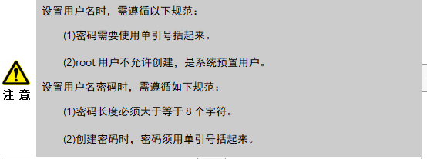
密码复杂度和密码修改 (3)
（3）连接数据库后，进入SQL 命令界面。创建用户 annie，密码为 Gauss_234。代码如下。
CREATE USER annie IDENTIFIED BY ‘Gauss_234’;
Text
Text
Text
Text
Text
Text
Text
Text
Text
Text
Text
Text
Text
Text
Text
Text
Text
Text
Text
Text
Text
Text
Text
Text
Text
Text
Text
Text
Text
Text
Text
Text
Text
Text
Text
Text
Text
Text
Text
Text
Text
Text
Text
Text
Text
Text
Notes:
数据库技术概念来源《数据库原理及应用》第2版，何玉洁 刘福刚 主编， 2012.3 人民邮电出版社出版。
这四个基本概念的划分来源 《数据库系统概论》第5版，王珊 萨师煊 编著， 2014.9 高等教育出版社出版。
数据库技术包含四个相关概念：数据，数据库，数据库管理系统，数据库系统。

Slide 148
密码复杂度和密码修改 (4)
（4）修改 annie 用户信息，如将用户 annie 的密码修改为#database_123。代码如下。
ALTER USER annie IDENTIFIED BY ‘#database_123’;
修改结果为：
mysql> ALTER USER annie IDENTIFIED BY ‘#database_123’;
Query OK, 0 rows affected (0.01 sec)
Text
Text
Text
Text
Text
Text
Text
Text
Text
Text
Text
Text
Text
Text
Text
Text
Text
Text
Text
Text
Text
Text
Text
Text
Text
Text
Text
Text
Text
Text
Text
Text
Text
Text
Text
Text
Text
Text
Text
Text
Text
Text
Text
Text
Text
Text
Notes:
数据库技术概念来源《数据库原理及应用》第2版，何玉洁 刘福刚 主编， 2012.3 人民邮电出版社出版。
这四个基本概念的划分来源 《数据库系统概论》第5版，王珊 萨师煊 编著， 2014.9 高等教育出版社出版。
数据库技术包含四个相关概念：数据，数据库，数据库管理系统，数据库系统。

Slide 149
密码复杂度和密码修改 (5)
（5）尝试修改用户 annie 的密码为 data_1。代码如下。修改结果为：
ALTER USER annie IDENTIFIED BY ‘data_1’;
此次修改密码会失败，是因为新密码长度不足 8 个字符，如下所示：
mysql> ALTER USER annie IDENTIFIED BY ‘data_1’;
ERROR 1819 (HY000): Your password does not satisfy the current policy requirements
Text
Text
Text
Text
Text
Text
Text
Text
Text
Text
Text
Text
Text
Text
Text
Text
Text
Text
Text
Text
Text
Text
Text
Text
Text
Text
Text
Text
Text
Text
Text
Text
Text
Text
Text
Text
Text
Text
Text
Text
Text
Text
Text
Text
Text
Text
Notes:
数据库技术概念来源《数据库原理及应用》第2版，何玉洁 刘福刚 主编， 2012.3 人民邮电出版社出版。
这四个基本概念的划分来源 《数据库系统概论》第5版，王珊 萨师煊 编著， 2014.9 高等教育出版社出版。
数据库技术包含四个相关概念：数据，数据库，数据库管理系统，数据库系统。

Slide 150
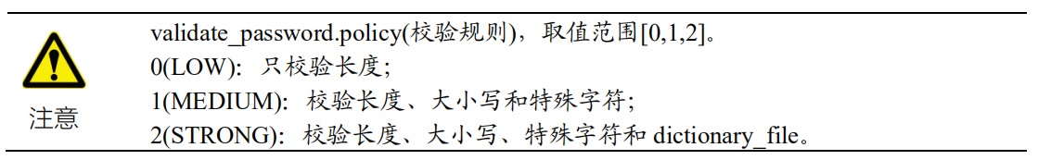
密码复杂度和密码修改 (6)
（6）查看密码策略。
SHOW VARIABLES LIKE ‘validate_password%’;
+--------------------------------------+-------+
| Variable_name | Value |
+--------------------------------------+-------+
| validate_password.check_user_name | ON |
| validate_password.dictionary_file | |
| validate_password.length | 8 |
| validate_password.mixed_case_count | 1 |
| validate_password.number_count | 1 |
| validate_password.policy | LOW |
| validate_password.special_char_count | 1 |
+--------------------------------------+-------+
7 rows in set (0.01 sec)
Text
Text
Text
Text
Text
Text
Text
Text
Text
Text
Text
Text
Text
Text
Text
Text
Text
Text
Text
Text
Text
Text
Text
Text
Text
Text
Text
Text
Text
Text
Text
Text
Text
Text
Text
Text
Text
Text
Text
Text
Text
Text
Text
Text
Text
Text
Notes:
数据库技术概念来源《数据库原理及应用》第2版，何玉洁 刘福刚 主编， 2012.3 人民邮电出版社出版。
这四个基本概念的划分来源 《数据库系统概论》第5版，王珊 萨师煊 编著， 2014.9 高等教育出版社出版。
数据库技术包含四个相关概念：数据，数据库，数据库管理系统，数据库系统。

Slide 151
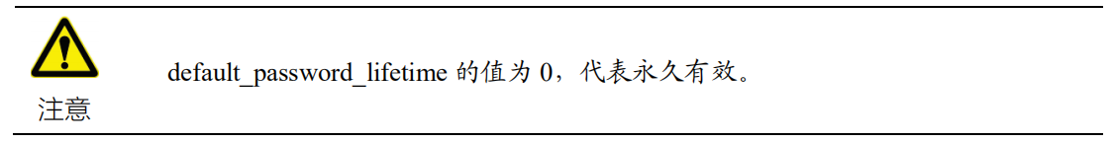
密码有效期 (1)
（1）查看已配置的 default_password_lifetime 参数密码有效期)。
mysql> show variables like ‘default_password_lifetime’;
+---------------------------+-------+
| Variable_name | Value |
+---------------------------+-------+
| default_password_lifetime | 0 |
+---------------------------+-------+
1 row in set (0.01 sec)
Text
Text
Text
Text
Text
Text
Text
Text
Text
Text
Text
Text
Text
Text
Text
Text
Text
Text
Text
Text
Text
Text
Text
Text
Text
Text
Text
Text
Text
Text
Text
Text
Text
Text
Text
Text
Text
Text
Text
Text
Text
Text
Text
Text
Text
Text
Notes:
数据库技术概念来源《数据库原理及应用》第2版，何玉洁 刘福刚 主编， 2012.3 人民邮电出版社出版。
这四个基本概念的划分来源 《数据库系统概论》第5版，王珊 萨师煊 编著， 2014.9 高等教育出版社出版。
数据库技术包含四个相关概念：数据，数据库，数据库管理系统，数据库系统。

Slide 152
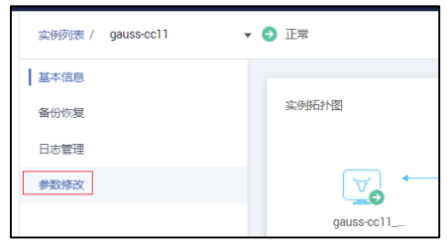
密码有效期 (2)
（2）更改 default_password_lifetime 参数，以 90 为例。
登录华为云，选择 GaussDB 服务，单击对应实例名称。如图所示。
选择参数修改，如图所示。
Text
Text
Text
Text
Text
Text
Text
Text
Text
Text
Text
Text
Text
Text
Text
Text
Text
Text
Text
Text
Text
Text
Text
Text
Text
Text
Text
Text
Text
Text
Text
Text
Text
Text
Text
Text
Text
Text
Text
Text
Text
Text
Text
Text
Text
Text
Notes:
数据库技术概念来源《数据库原理及应用》第2版，何玉洁 刘福刚 主编， 2012.3 人民邮电出版社出版。
这四个基本概念的划分来源 《数据库系统概论》第5版，王珊 萨师煊 编著， 2014.9 高等教育出版社出版。
数据库技术包含四个相关概念：数据，数据库，数据库管理系统，数据库系统。

Slide 153
密码有效期 (3)
（3）再次查看密码有效期天数，已重置为 90。
mysql> show variables like ‘default_password_lifetime’;
+---------------------------+-------+
| Variable_name | Value |
+---------------------------+-------+
| default_password_lifetime | 90 |
+---------------------------+-------+
1 row in set (0.01 sec)
Text
Text
Text
Text
Text
Text
Text
Text
Text
Text
Text
Text
Text
Text
Text
Text
Text
Text
Text
Text
Text
Text
Text
Text
Text
Text
Text
Text
Text
Text
Text
Text
Text
Text
Text
Text
Text
Text
Text
Text
Text
Text
Text
Text
Text
Text
Notes:
数据库技术概念来源《数据库原理及应用》第2版，何玉洁 刘福刚 主编， 2012.3 人民邮电出版社出版。
这四个基本概念的划分来源 《数据库系统概论》第5版，王珊 萨师煊 编著， 2014.9 高等教育出版社出版。
数据库技术包含四个相关概念：数据，数据库，数据库管理系统，数据库系统。

Slide 154
3.3 审计实验
3.3 审计实验
Text
Text
Text
Text
Text
Text
Text
Text
Text
Text
Text
Text
Text
Text
Text
Text
Text
Text
Text
Text
Text
Text
Text
Text
Text
Text
Text
Text
Text
Text
Text
Text
Text
Text
Text
Text
Text
Text
Text
Text
Text
Text
Text
Text
Text
Text
Notes:
数据库技术概念来源《数据库原理及应用》第2版，何玉洁 刘福刚 主编， 2012.3 人民邮电出版社出版。
这四个基本概念的划分来源 《数据库系统概论》第5版，王珊 萨师煊 编著， 2014.9 高等教育出版社出版。
数据库技术包含四个相关概念：数据，数据库，数据库管理系统，数据库系统。

Slide 155
实验介绍
关于本实验：设置了完善的密码安全策略，保证数据安全。
安全策略主要分为密码复杂度、密码重用、密码有效期、密码修改和密码验证五个部分。
密码验证是指用户连接数据库时密码正确性的校验。
实验目的：掌握设置密码安全策略的方法，包括密码复杂度、密码有效期和密码修改。
Text
Text
Text
Text
Text
Text
Text
Text
Text
Text
Text
Text
Text
Text
Text
Text
Text
Text
Text
Text
Text
Text
Text
Text
Text
Text
Text
Text
Text
Text
Text
Text
Text
Text
Text
Text
Text
Text
Text
Text
Text
Text
Text
Text
Text
Text
Notes:
数据库技术概念来源《数据库原理及应用》第2版，何玉洁 刘福刚 主编， 2012.3 人民邮电出版社出版。
这四个基本概念的划分来源 《数据库系统概论》第5版，王珊 萨师煊 编著， 2014.9 高等教育出版社出版。
数据库技术包含四个相关概念：数据，数据库，数据库管理系统，数据库系统。

Slide 156
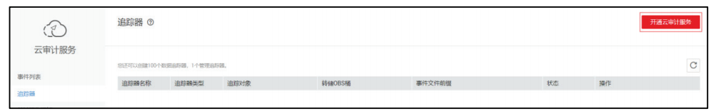
开启审计 (1)
（1）登录华为云开通云审计服务。如图所示。
Text
Text
Text
Text
Text
Text
Text
Text
Text
Text
Text
Text
Text
Text
Text
Text
Text
Text
Text
Text
Text
Text
Text
Text
Text
Text
Text
Text
Text
Text
Text
Text
Text
Text
Text
Text
Text
Text
Text
Text
Text
Text
Text
Text
Text
Text
Notes:
数据库技术概念来源《数据库原理及应用》第2版，何玉洁 刘福刚 主编， 2012.3 人民邮电出版社出版。
这四个基本概念的划分来源 《数据库系统概论》第5版，王珊 萨师煊 编著， 2014.9 高等教育出版社出版。
数据库技术包含四个相关概念：数据，数据库，数据库管理系统，数据库系统。

Slide 157
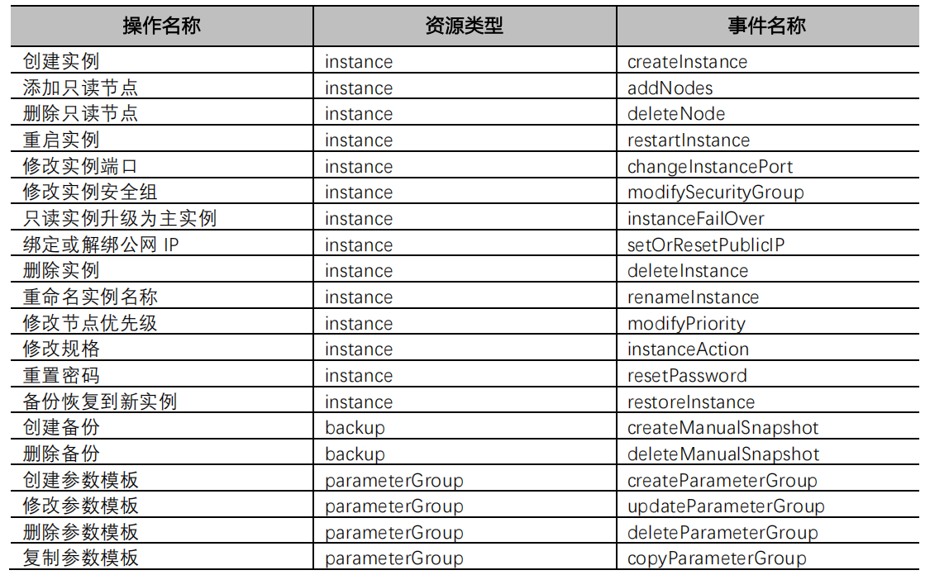
开启审计 (2)
CTS支持的主要操作事件如下表。 云审计服务支持的 GaussDB(for MySQL)操作列表，如表所示。
Text
Text
Text
Text
Text
Text
Text
Text
Text
Text
Text
Text
Text
Text
Text
Text
Text
Text
Text
Text
Text
Text
Text
Text
Text
Text
Text
Text
Text
Text
Text
Text
Text
Text
Text
Text
Text
Text
Text
Text
Text
Text
Text
Text
Text
Text
Notes:
数据库技术概念来源《数据库原理及应用》第2版，何玉洁 刘福刚 主编， 2012.3 人民邮电出版社出版。
这四个基本概念的划分来源 《数据库系统概论》第5版，王珊 萨师煊 编著， 2014.9 高等教育出版社出版。
数据库技术包含四个相关概念：数据，数据库，数据库管理系统，数据库系统。

Slide 158
开启审计 (3)
（2）配置追踪器。如图 所示。
Text
Text
Text
Text
Text
Text
Text
Text
Text
Text
Text
Text
Text
Text
Text
Text
Text
Text
Text
Text
Text
Text
Text
Text
Text
Text
Text
Text
Text
Text
Text
Text
Text
Text
Text
Text
Text
Text
Text
Text
Text
Text
Text
Text
Text
Text
Notes:
数据库技术概念来源《数据库原理及应用》第2版，何玉洁 刘福刚 主编， 2012.3 人民邮电出版社出版。
这四个基本概念的划分来源 《数据库系统概论》第5版，王珊 萨师煊 编著， 2014.9 高等教育出版社出版。
数据库技术包含四个相关概念：数据，数据库，数据库管理系统，数据库系统。

Slide 159
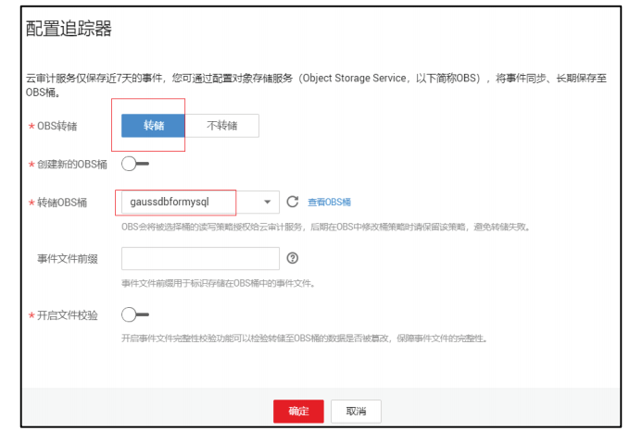
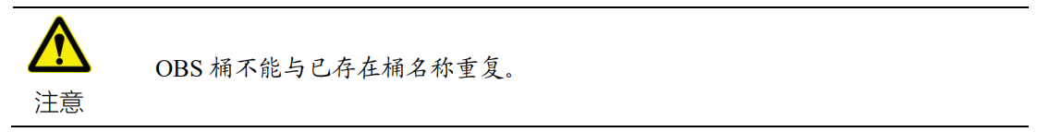
开启审计 (4)
可以将云审计日志存入华为云对象存储服务中。如图所示。
Text
Text
Text
Text
Text
Text
Text
Text
Text
Text
Text
Text
Text
Text
Text
Text
Text
Text
Text
Text
Text
Text
Text
Text
Text
Text
Text
Text
Text
Text
Text
Text
Text
Text
Text
Text
Text
Text
Text
Text
Text
Text
Text
Text
Text
Text
Notes:
数据库技术概念来源《数据库原理及应用》第2版，何玉洁 刘福刚 主编， 2012.3 人民邮电出版社出版。
这四个基本概念的划分来源 《数据库系统概论》第5版，王珊 萨师煊 编著， 2014.9 高等教育出版社出版。
数据库技术包含四个相关概念：数据，数据库，数据库管理系统，数据库系统。

Slide 160
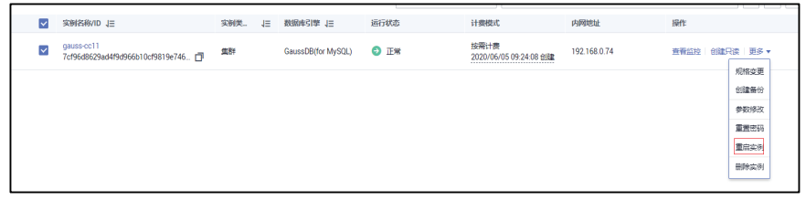
验证审计 (1)
（1）重启 GaussDB 实例。如图 3-15 所示。
Text
Text
Text
Text
Text
Text
Text
Text
Text
Text
Text
Text
Text
Text
Text
Text
Text
Text
Text
Text
Text
Text
Text
Text
Text
Text
Text
Text
Text
Text
Text
Text
Text
Text
Text
Text
Text
Text
Text
Text
Text
Text
Text
Text
Text
Text
Notes:
数据库技术概念来源《数据库原理及应用》第2版，何玉洁 刘福刚 主编， 2012.3 人民邮电出版社出版。
这四个基本概念的划分来源 《数据库系统概论》第5版，王珊 萨师煊 编著， 2014.9 高等教育出版社出版。
数据库技术包含四个相关概念：数据，数据库，数据库管理系统，数据库系统。

Slide 161
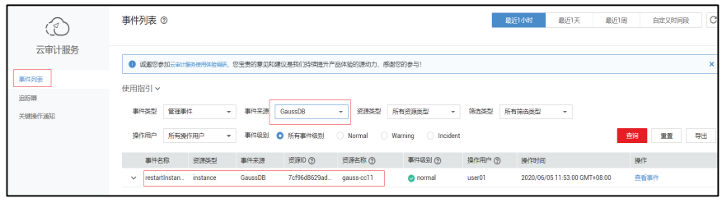
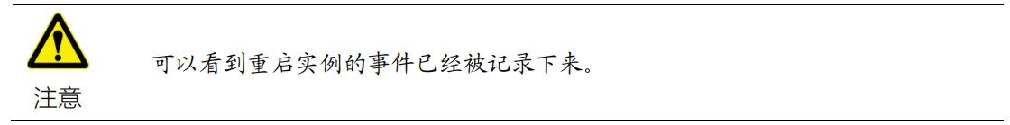
验证审计 (2)
（2）查看云审计服务事件列表，选择事件来源：GaussDB。如图所示。
Text
Text
Text
Text
Text
Text
Text
Text
Text
Text
Text
Text
Text
Text
Text
Text
Text
Text
Text
Text
Text
Text
Text
Text
Text
Text
Text
Text
Text
Text
Text
Text
Text
Text
Text
Text
Text
Text
Text
Text
Text
Text
Text
Text
Text
Text
Notes:
数据库技术概念来源《数据库原理及应用》第2版，何玉洁 刘福刚 主编， 2012.3 人民邮电出版社出版。
这四个基本概念的划分来源 《数据库系统概论》第5版，王珊 萨师煊 编著， 2014.9 高等教育出版社出版。
数据库技术包含四个相关概念：数据，数据库，数据库管理系统，数据库系统。

Slide 162
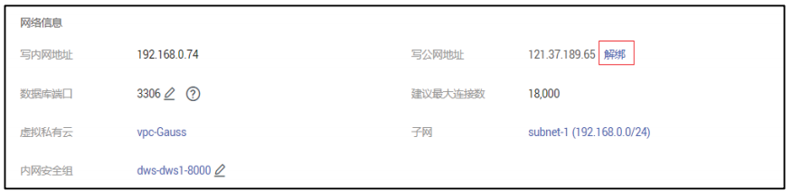
验证审计 (3)
（3）解绑数据库公网地址。如图所示。
Text
Text
Text
Text
Text
Text
Text
Text
Text
Text
Text
Text
Text
Text
Text
Text
Text
Text
Text
Text
Text
Text
Text
Text
Text
Text
Text
Text
Text
Text
Text
Text
Text
Text
Text
Text
Text
Text
Text
Text
Text
Text
Text
Text
Text
Text
Notes:
数据库技术概念来源《数据库原理及应用》第2版，何玉洁 刘福刚 主编， 2012.3 人民邮电出版社出版。
这四个基本概念的划分来源 《数据库系统概论》第5版，王珊 萨师煊 编著， 2014.9 高等教育出版社出版。
数据库技术包含四个相关概念：数据，数据库，数据库管理系统，数据库系统。

Slide 163
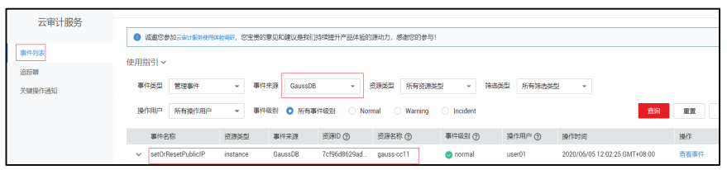
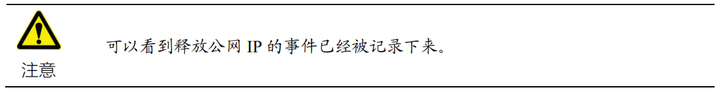
验证审计 (4)
（4）查看云审计服务事件列表，选择事件来源：GaussDB。如图所示。
Text
Text
Text
Text
Text
Text
Text
Text
Text
Text
Text
Text
Text
Text
Text
Text
Text
Text
Text
Text
Text
Text
Text
Text
Text
Text
Text
Text
Text
Text
Text
Text
Text
Text
Text
Text
Text
Text
Text
Text
Text
Text
Text
Text
Text
Text
Notes:
数据库技术概念来源《数据库原理及应用》第2版，何玉洁 刘福刚 主编， 2012.3 人民邮电出版社出版。
这四个基本概念的划分来源 《数据库系统概论》第5版，王珊 萨师煊 编著， 2014.9 高等教育出版社出版。
数据库技术包含四个相关概念：数据，数据库，数据库管理系统，数据库系统。

